Slide 1

Papua New Guinea National GBV Strategy Review 2025
A review and update of the current 2016 to 2025 strategy based on progress to date, emerging issues and trends, updated evidence of GBV, changes in coordination and governance, and the policy and legal environment in line with MTDPV and Vision 2050.

Slide 2
Introduction
The National Strategy to Prevent and Respond to Gender-Based Violence 2016 to 2025 is due to expire at the end of 2025. The research presented in this report is part of the The National GBV Secretariat’s review process to prepare a new strategy that will span 2026 to 2035.
The research here includes the results of:
A Literature Review: that included the evaluation of more than 600 research reports.
A National Survey: of 5000+ Papua New Guineans on their attitudes towards, and experiences of, violence. The survey was conducted in 12 provinces in all four regions of the country. The sample was evenly divided between men and women with an 80/20 rural split. The sample also considered the youth bulge in the country through ensuring 40% of the survey participants were under the age of 30.
A Provincial Questionnaire: which included all twenty provinces plus the Autonomous Region of Bougainville and the National Capital District.
A National Listening Tour: that visited all four regions of the country and included representatives of 10 provinces which included more than representatives including Governors. Provincial Administrators and their teams, CSOs, health, law enforcement and magistrates, front line workers and survivors.
An Open Confidential Testimonial System to collect personal confidential testimonies from all Papua New Guineans nation-wide.
While each region, province, district, ward, village, family and individual, that participated presented unique challenges and experiences, all underlined the horrific, unchecked and growing impact of gender-based violence on the country. They all identified innovative solutions and offered complex insights on how to overcome gender-based violence.
The resilience of the rural communities, underfunded, under-coordinated, under-supported, was deeply moving, as was the passion with which some women and men gave their lives in the service of survivors and the future of their country. The results of the exponentially increasing rates of GBV deeply and profoundly alarming.

Slide 3



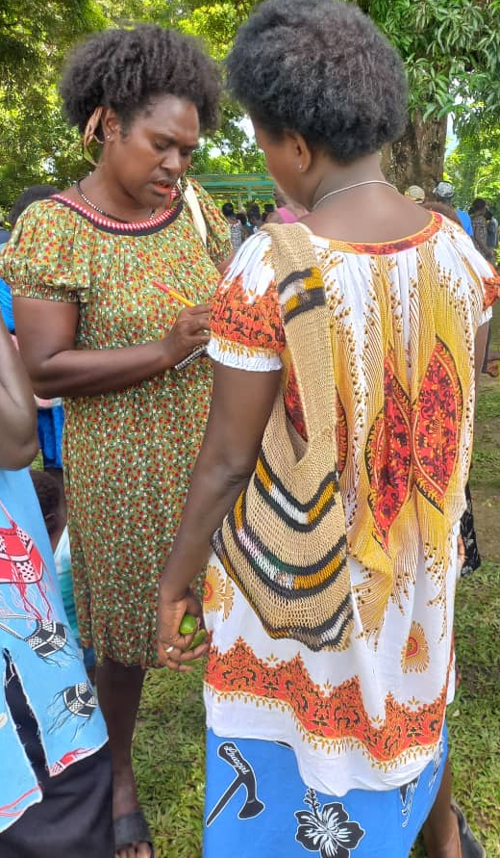
THE RESEARCH
SURVEY
DIALOGUE
PLAN
Collective strategic planning process
5000+ surveys
4 regions, 12 provinces
50/50 women/men
80/20 rural/urban
60/40 under/over 30
22 Provincial questionnaires
4 regions
10 provinces
all levels
1000+ participants
nation-wide testimonies
Notes:
Comprehensive analysis of the status of GBV in the country
Including
New National gender based violence strategic action plan

Slide 4
EMERGING TRENDS Between 1986 to 2025 the number of women experiencing GBV has increased by more than 210% (or 2,313,075 more women).
In 2025, 64% of women (~3.41 million) stated they experience intimate partner violence.
The Law Reform Commission (LRC) (PNGLRC 1992) – 1986 data
Papua New Guinea Demographic and Health Survey (2016-2018)
National GBV Review Survey 2025 (population estimate 10.5M)
Notes:
The team compared the results of our 2025 survey with data we could find first from the Law Commission Report of 1986, and then the Demographic Health Survey of 2016.
Then we extrapolated our data to population estimates for 2014 and if we continue at the same rate of change by 2046 we can anticipate that 19.78 million women will be experience GBV in our nation.
So you can the accelerated rate change we can anticipate if we stay our current course.

Slide 5
“ That does not mean wives and husbands must bash each other.”
“Just walk away from trouble.”
“There are always other ways to settle problems.”
“Such issues should be settled in a peaceful means by both couples.”
“No, I love my wife so much. I wouldn’t do anything to hurt her”
“There are other ways to settle marital issues.”
“Walking away is always an option.”
Violence in relationships is condoned.
“I hit my wife because we argue about all of the above.”
“I fight with my husband when he forces me to have sex.”
“Yes, I hit my wife when she argues with me.”
“I used to beat my former wife very badly, then she passed on.”
Even though many respondents understood what gender-based violence is and that couples should not beat each other.
M
Thoughts

Slide 6
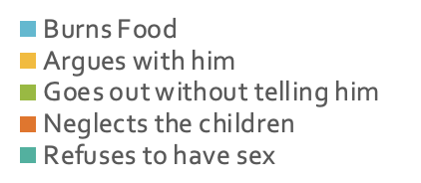
In 10 years, men’s attitudes towards GBV have worsened: 83% of men now believe they have a right to beat their wives.
78%
83%

Slide 7
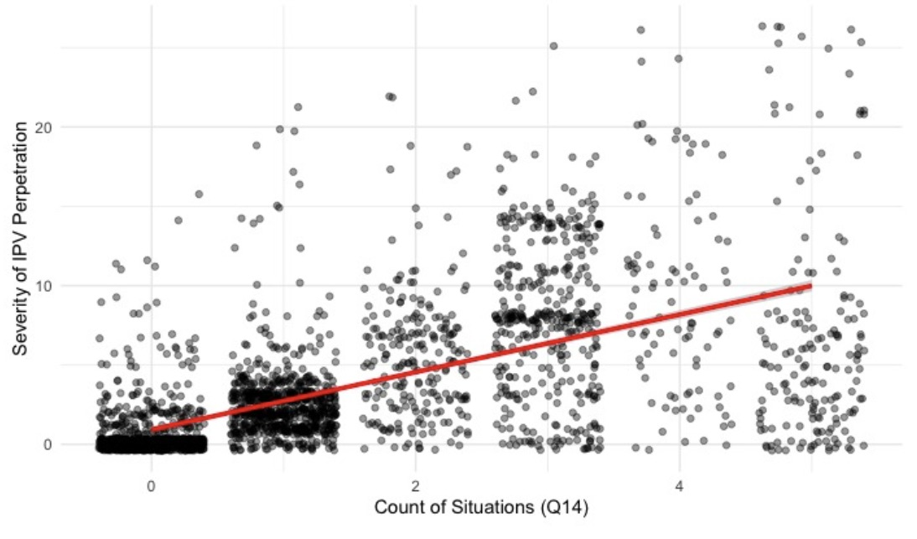
The more men justify beating their wives and partners, the more they perpetrate violence – even when they are fully aware that this violence is against the law.
Notes:
The greatest predictor of GBV is the attitudes of men towards – if they believe it ok – they are most going to perperate

Slide 8
Dr. Leonard Schein
Relationship violence is not isolated: individuals who have experienced relationship violence are 8.5 times more likely to also experience GBV in general.
41% of those under the age of 40 have perpetrated GBV.
51% of respondents witnessed their father beat their mother.
60% of those who witnessed their fathers beat their mothers do not think rape is GBV and are twice as likely to have beaten their partners or lived through their partners beating them.
Generational trauma from violence is a serious problem, and people under 40 are the highest risk.
Papua New Guinea Demographic and Health Survey 2016 – 2018, The National Statistical Office, Port Moresby, Papua New Guinea, The DHS Program, ICF, Rockville, Maryland, USA
World Bank
2025 National GBV Strategy Review Survey

Slide 9
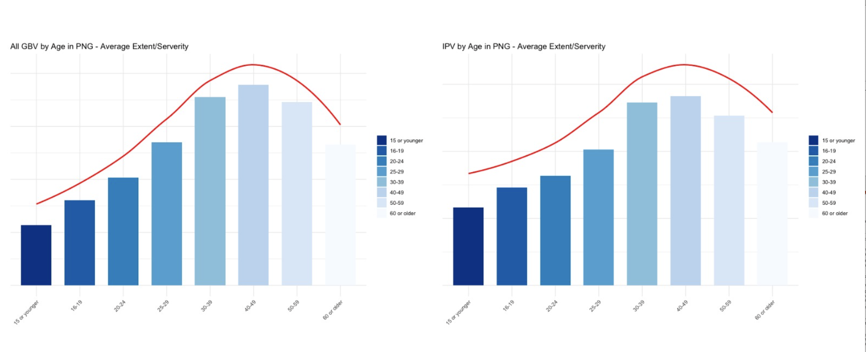
Those aged 30-39 are the most likely to experience GBV, whereas those aged 40-49, although fewer in number, experienced the highest severity and frequency of violence.
GBV by Age in PNG
Extend - Severity
IPV by Age in PNG
Extend - Severity

Slide 10
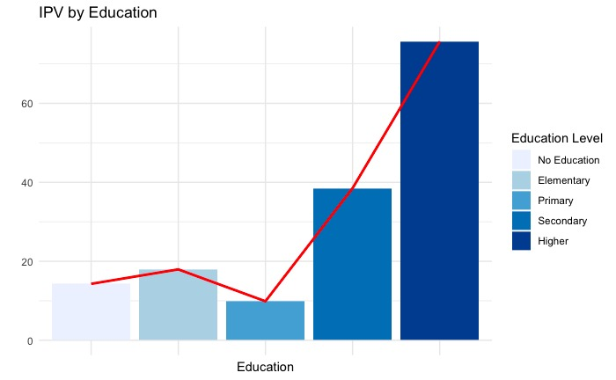
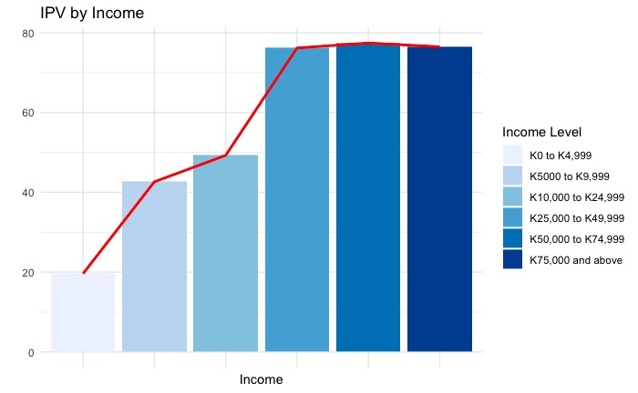
The higher the education the more likely of being wealthier (by 98.6%) but also the dramatically higher chance of experiencing GBV (by 58%).

Slide 11
From the strategic targets: in the last decade there has been literally no change in the % of women survivors who are economically independent and conviction rates are tragically low.

Slide 12
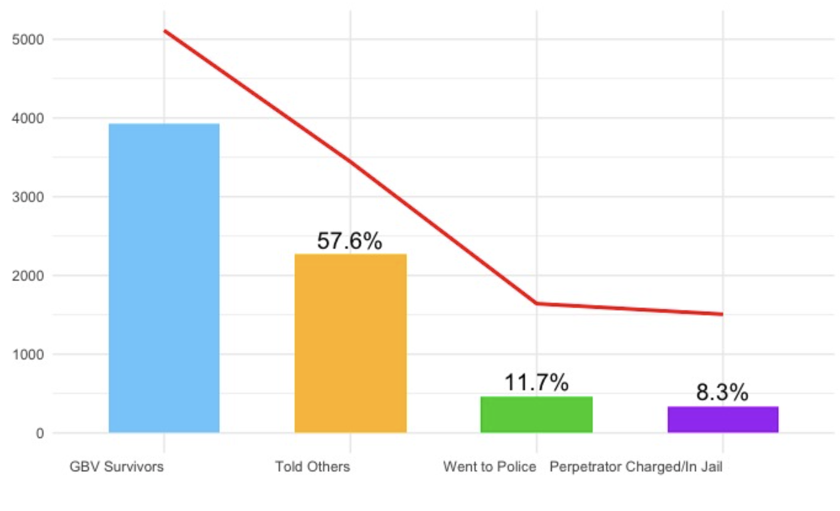
Of the nearly 4000 GBV survivors in the survey, 58% said they told someone, but only 12% said they reported the crime to the police and only 8% of those resulted in a conviction.
3932 GBV
survivors

Slide 13
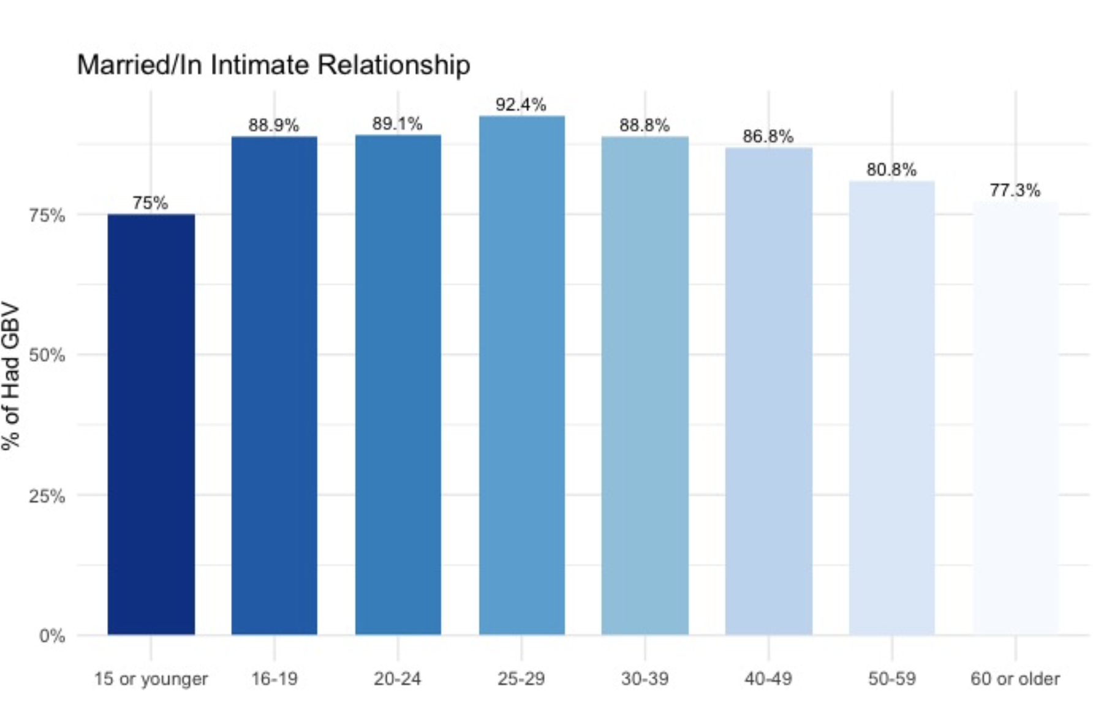
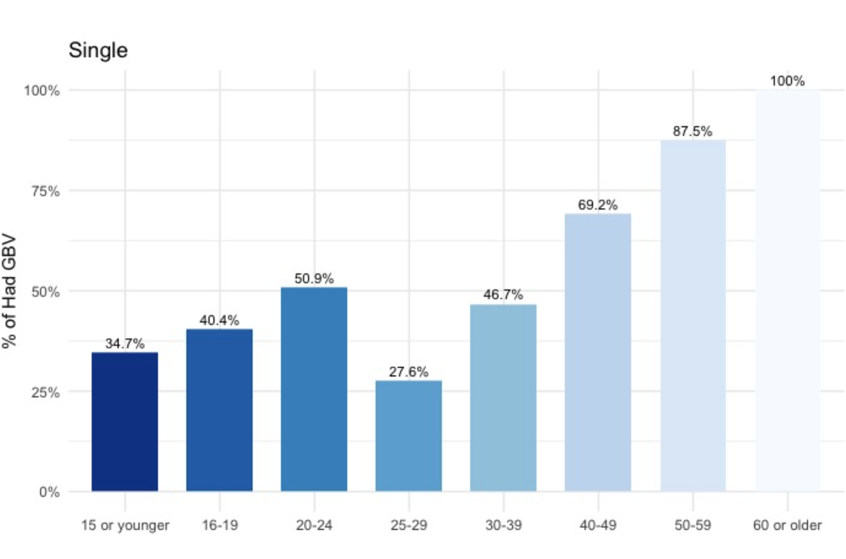
Out of all categories and ages, those who are married 25 to 29 are at the highest risk of experiencing GBV and those who are single 25 to 29 are at the lowest risk.

Slide 14
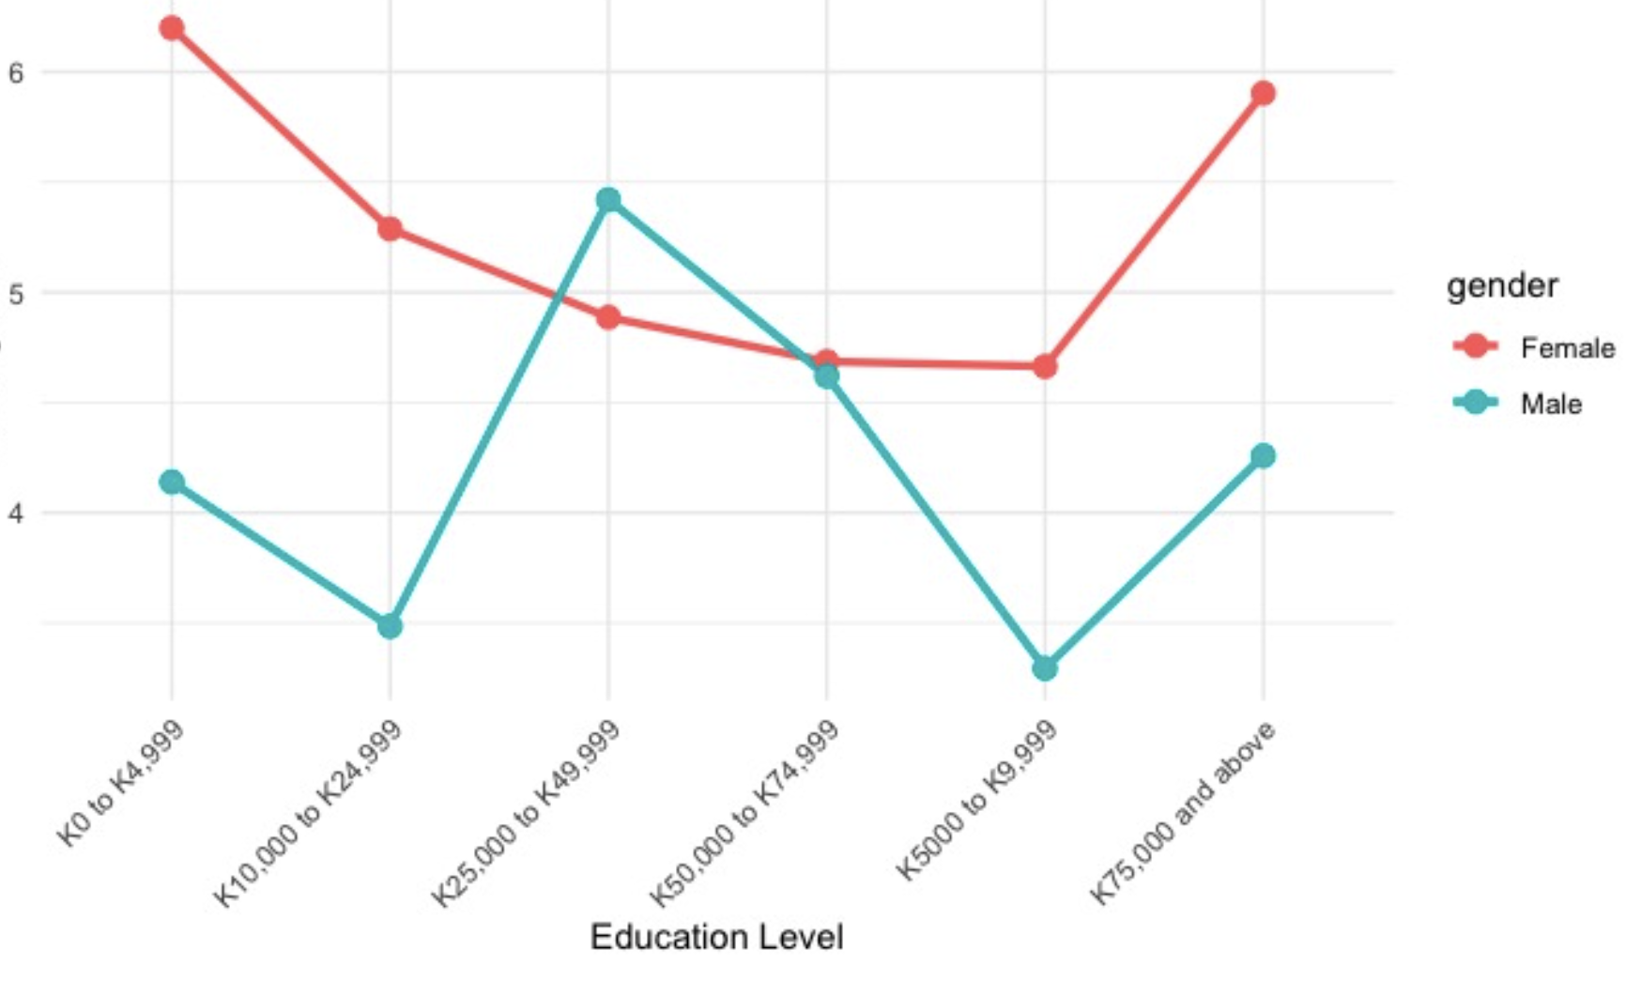
Those is the lowest income group, and the highest income group experience the most and nearly on par violence.

Slide 15
The response pathway is ineffective and perpetrates further trauma.
Justice: In 2022 (the most recent data available), there were 30,028 cases of GBV reported to FSVUs in PNG; from these only 1,304 resulted in arrests (4%) and of this only, 156 convictions (.5%).
Police: There are only 61 FSVUs, dedicated nation-wide and many of these are understaffed, undertrained, underfunded and without proper GBV SOPs.
Health: PNG has 35 hospitals, 732 health centers and 40 community health posts but only 39 FSCs and many of these are understaffed, underfunded and without proper GBV tools and SOPs.
Safe Houses: There are currently only 51 safe houses or safe shelters/accommodation operating in the country.
With no shared national data-base system or accountability mechanisms.
Notes:
This is not data from the survey but data collected through our deep dive literature review.

Slide 16
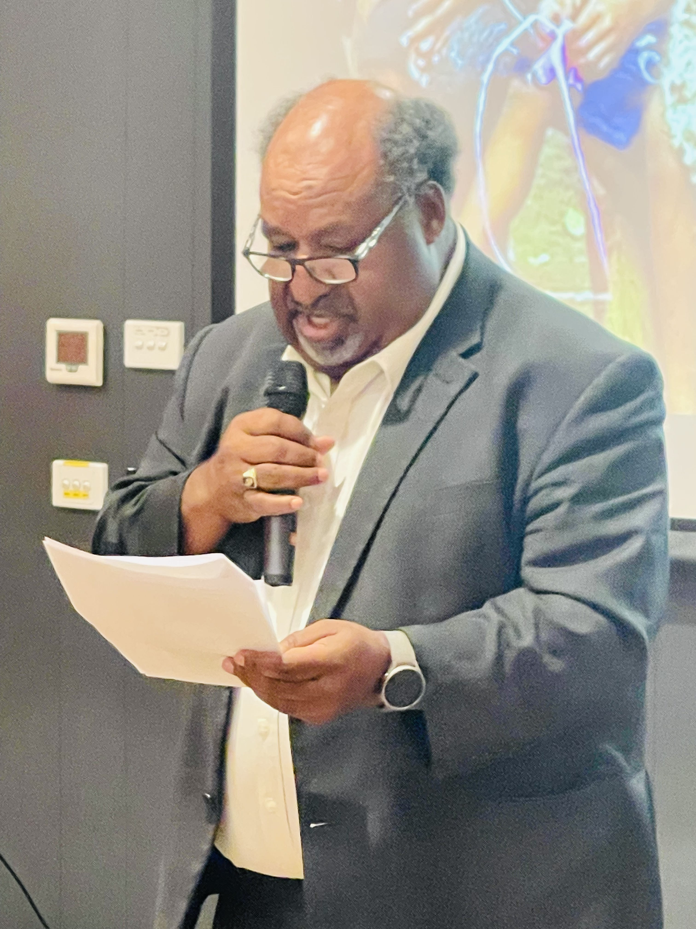
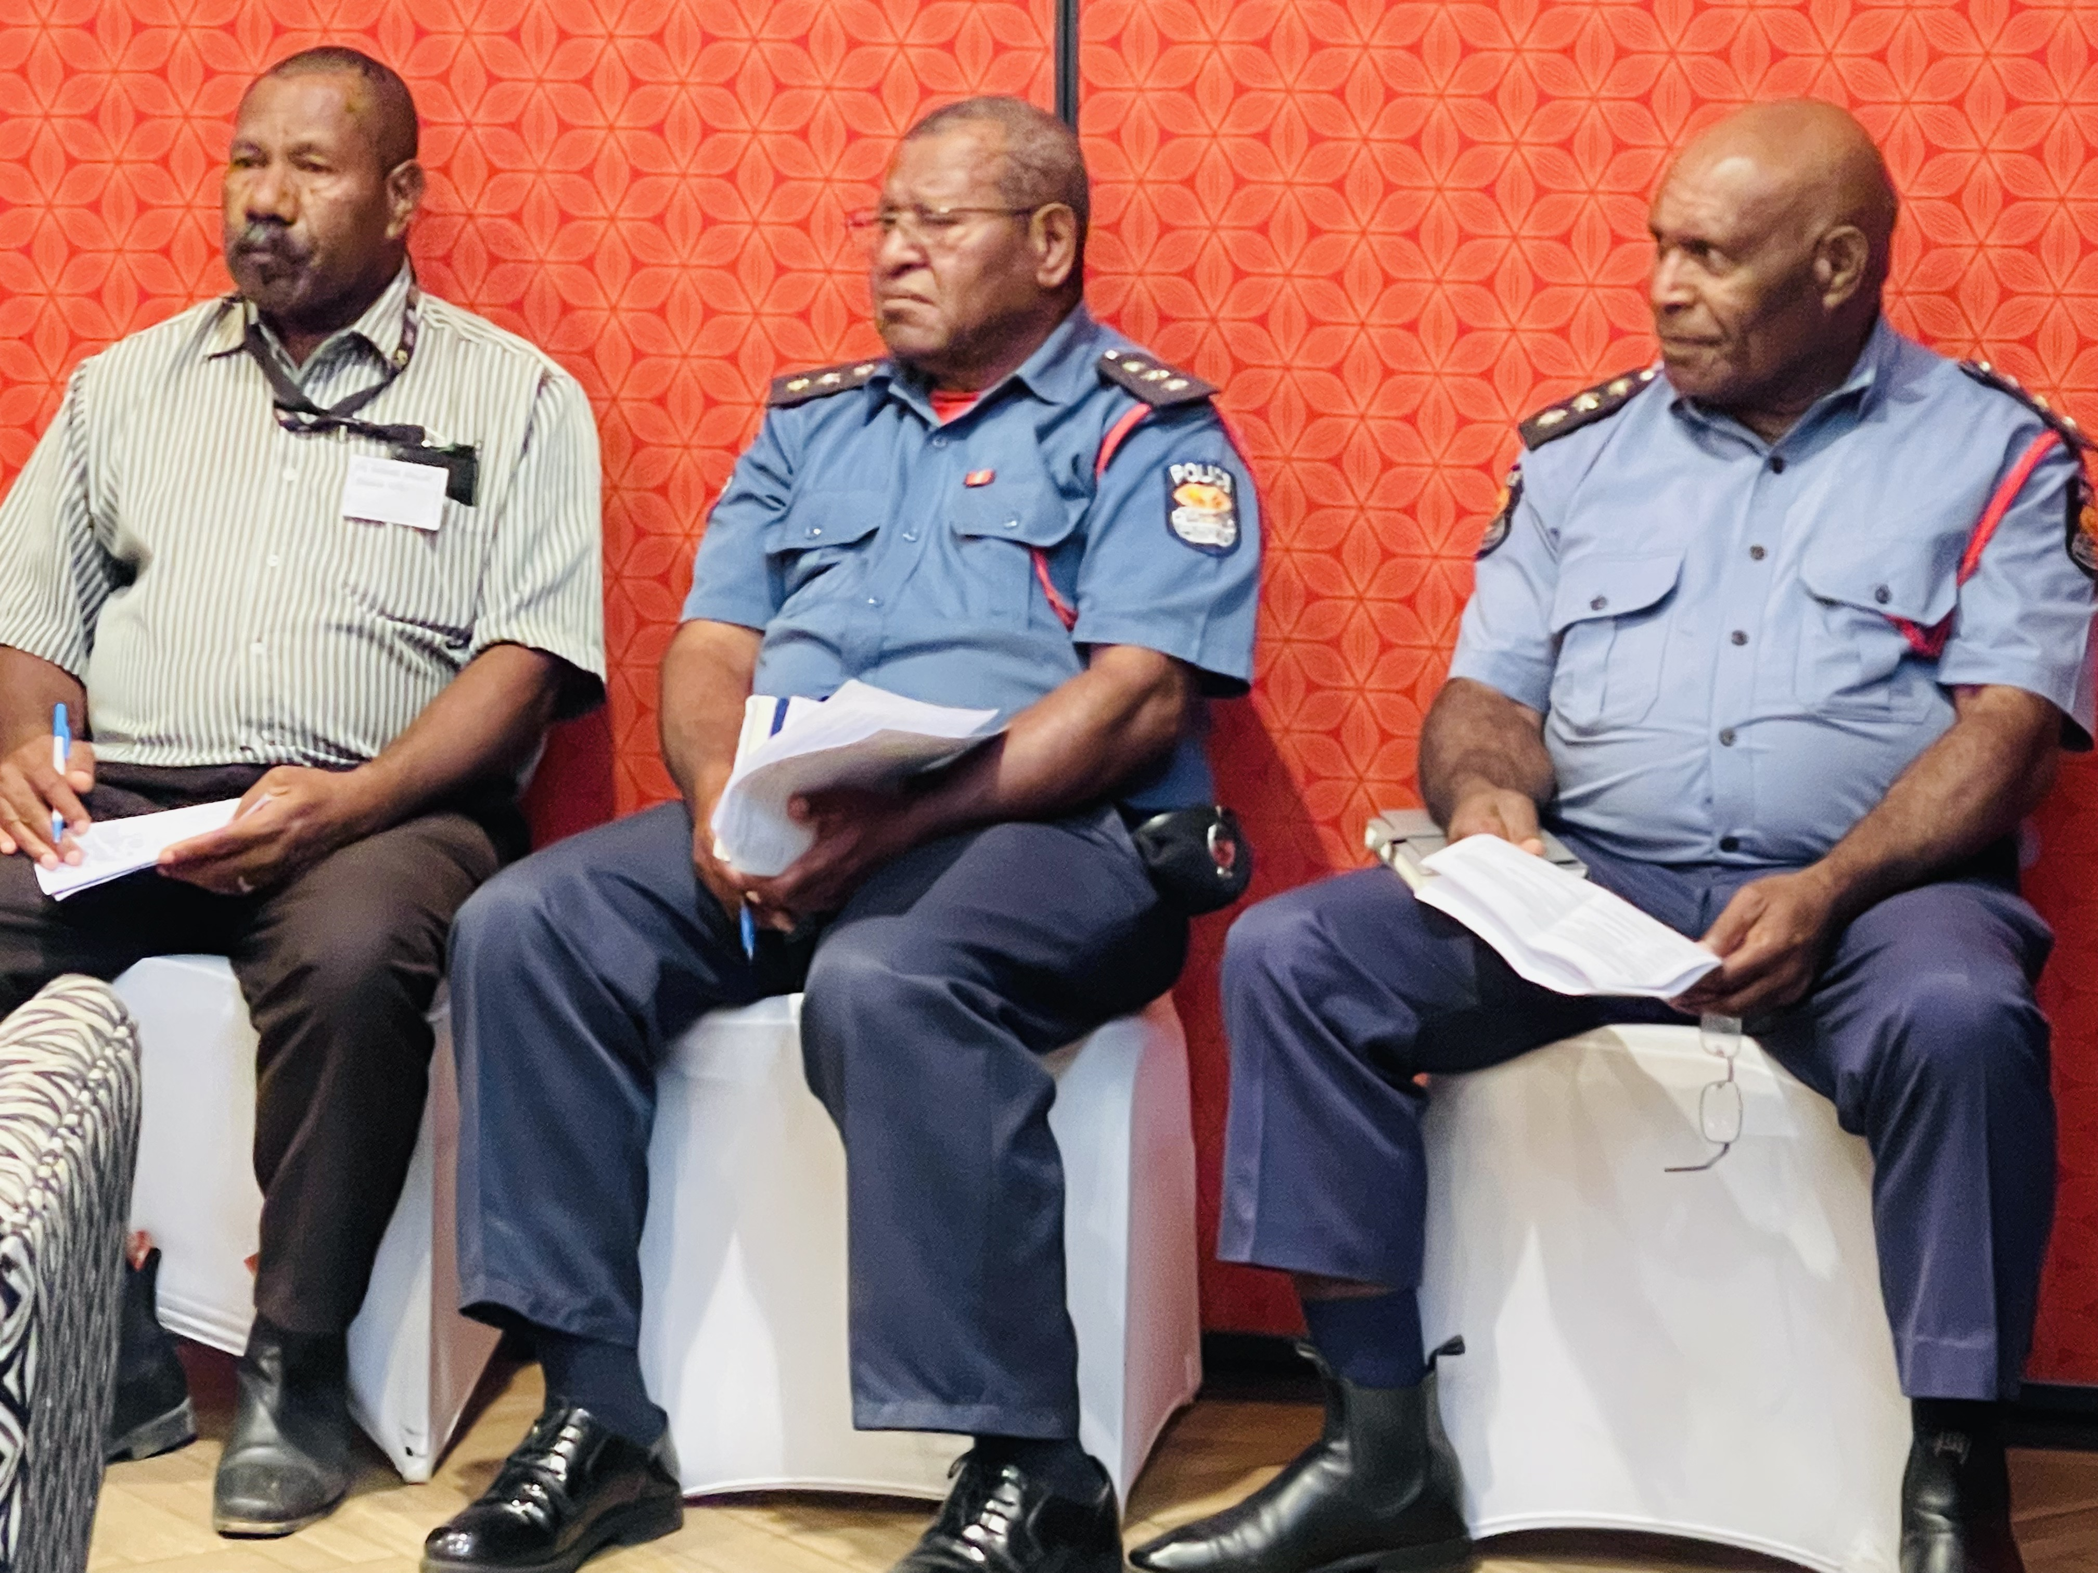
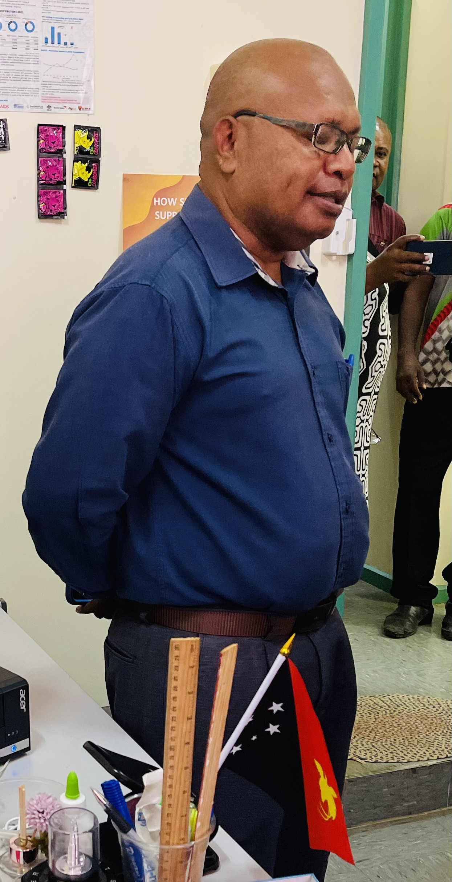
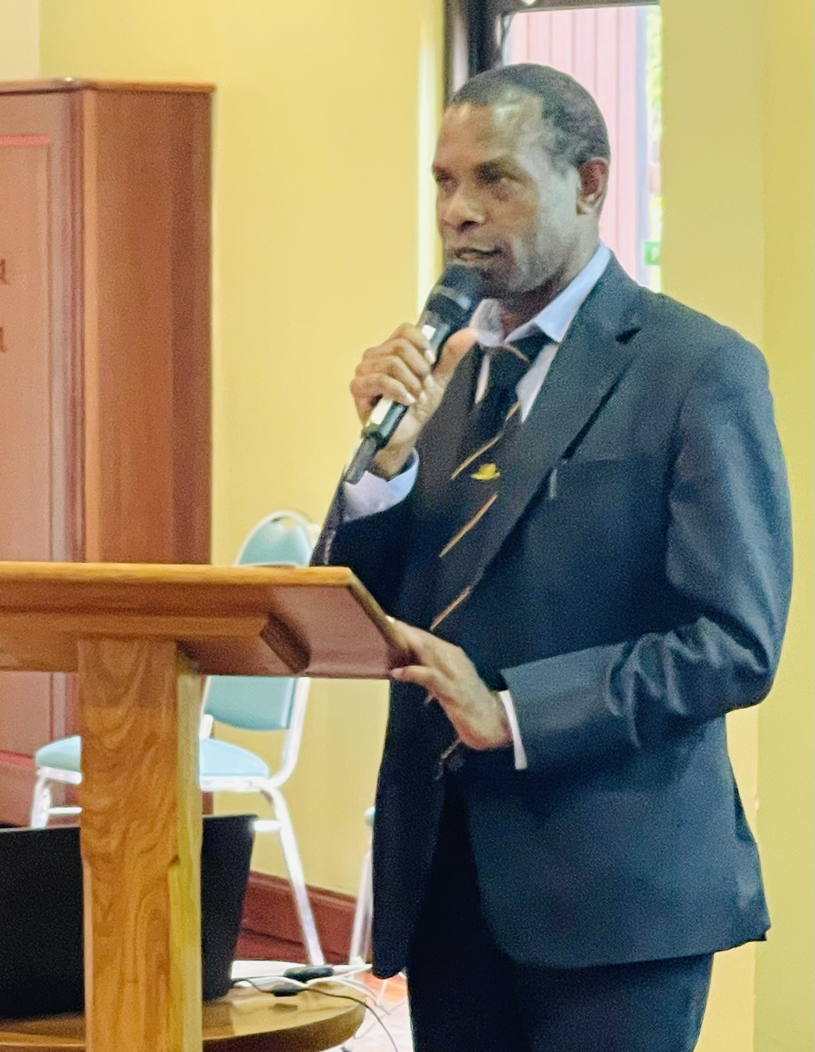
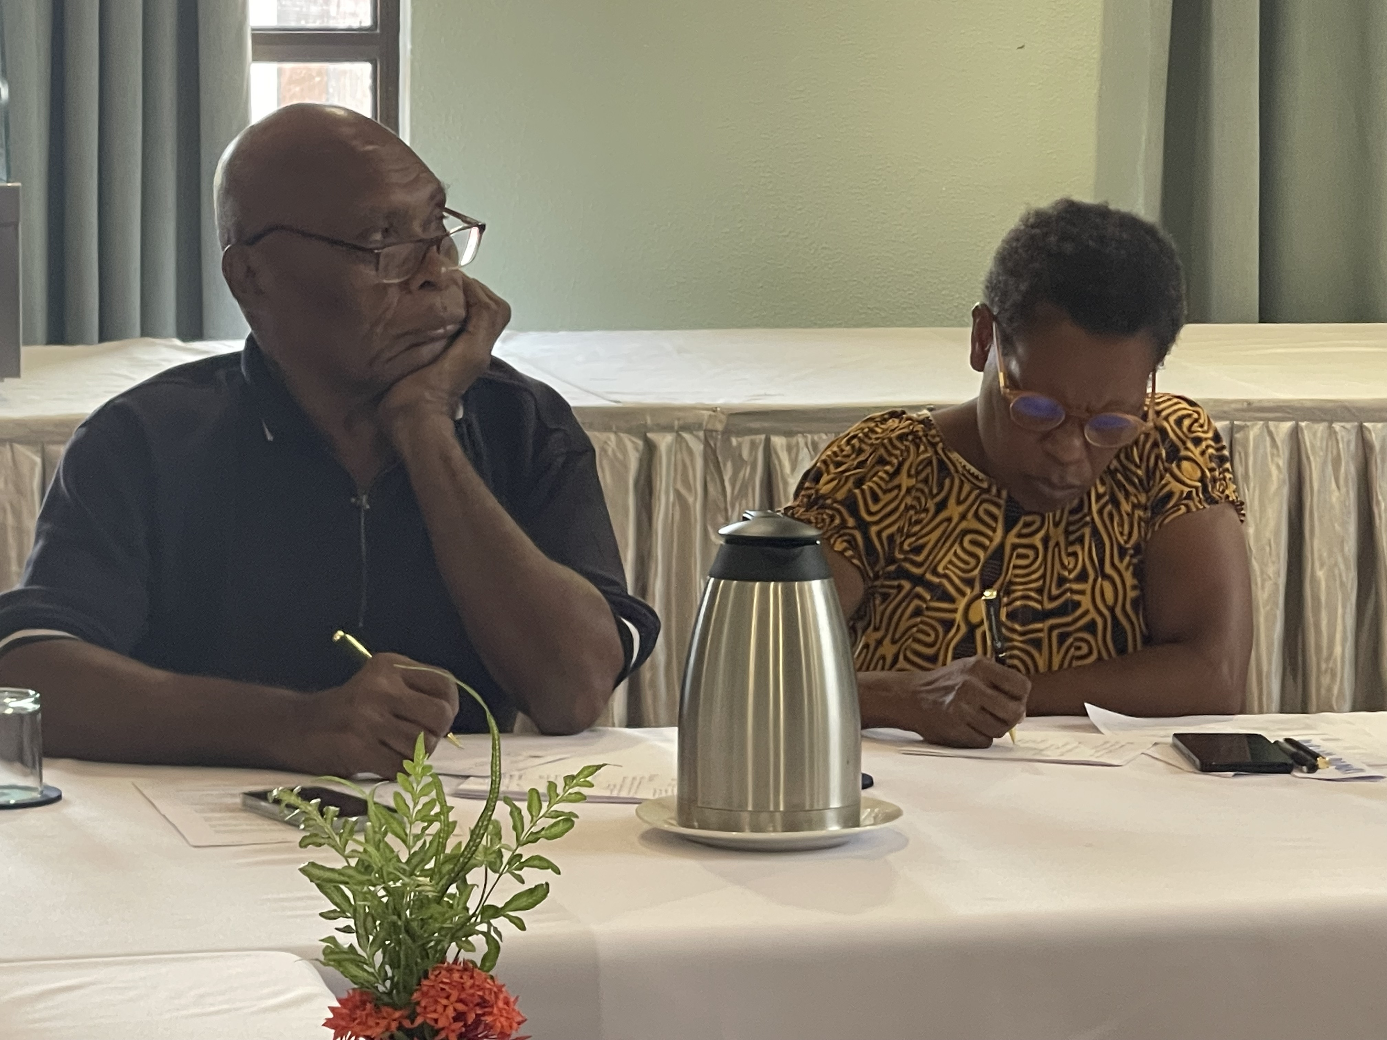
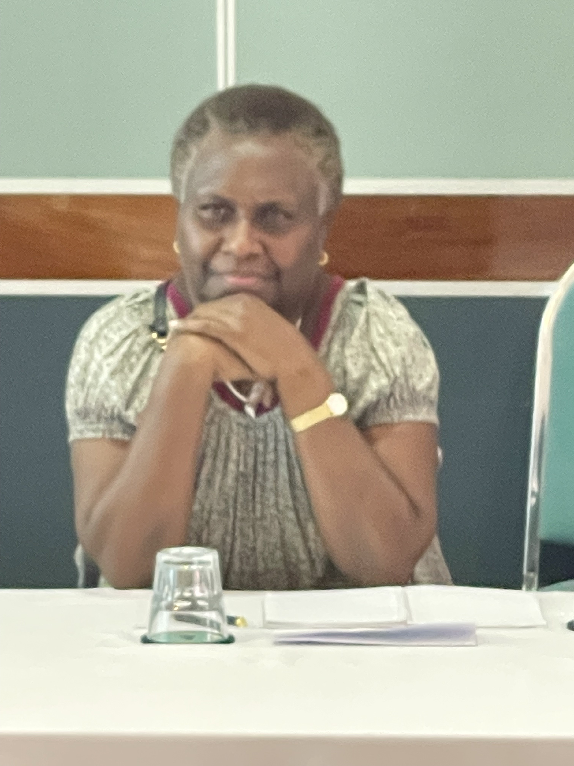
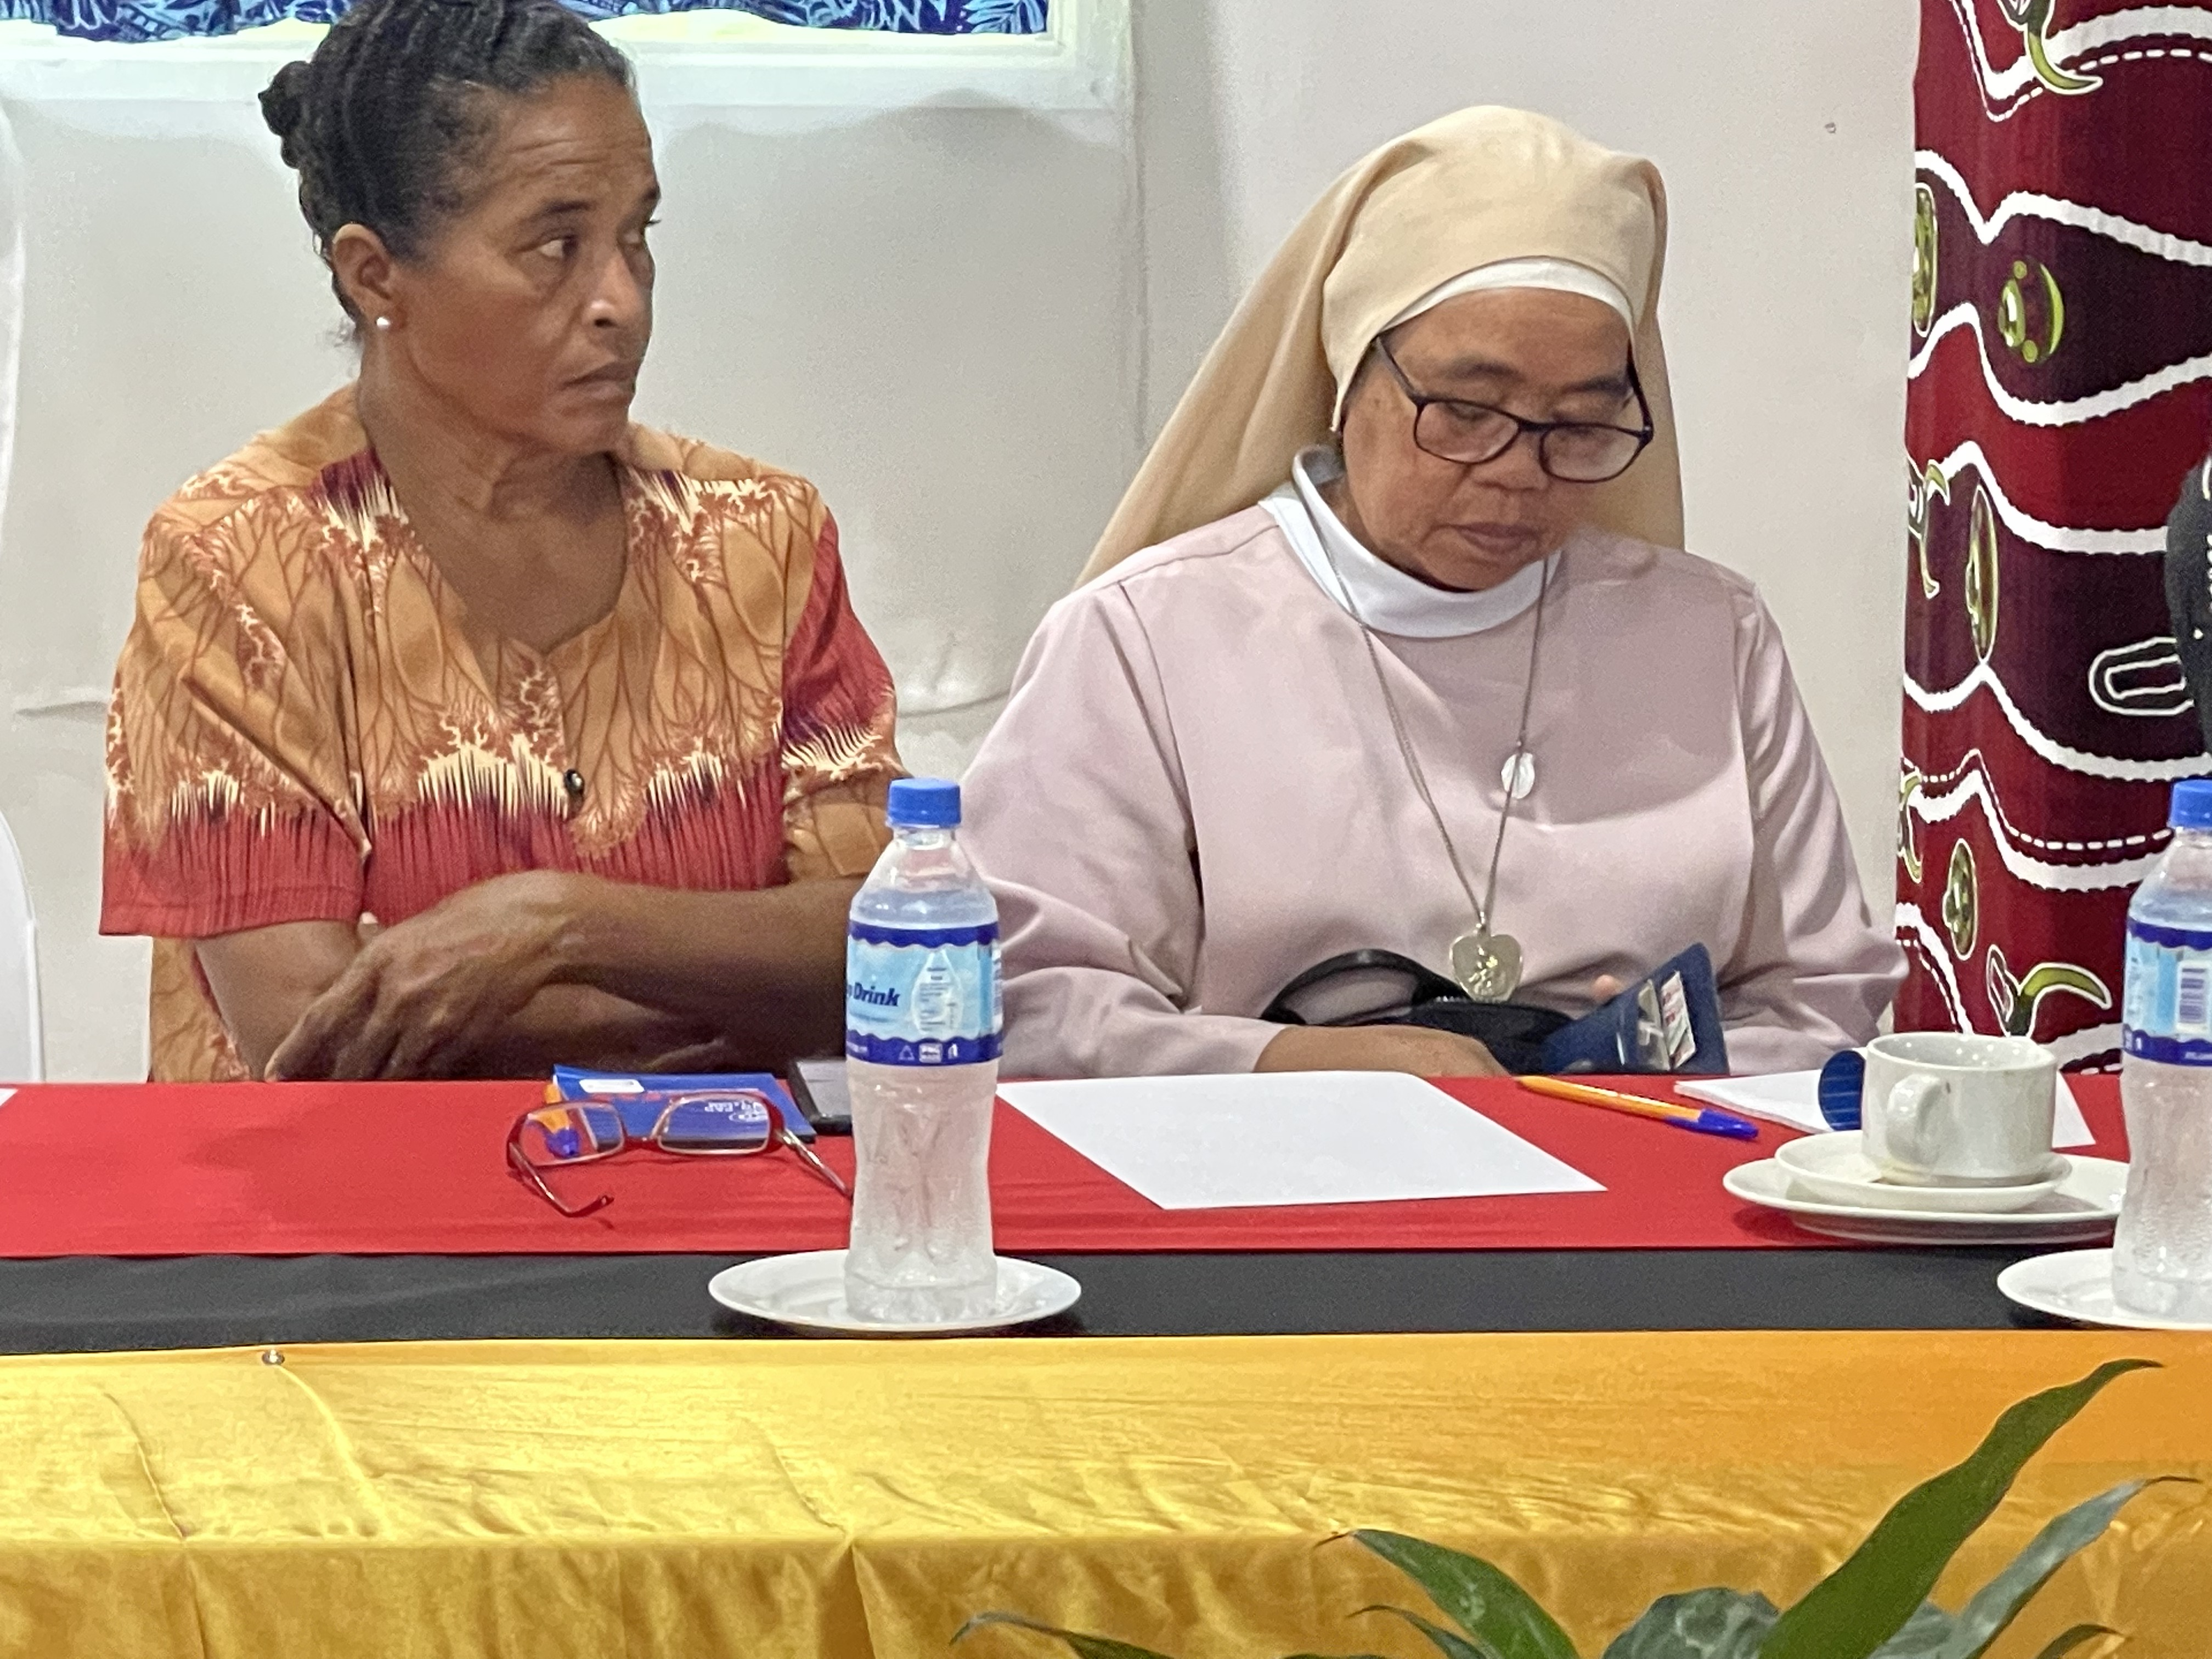
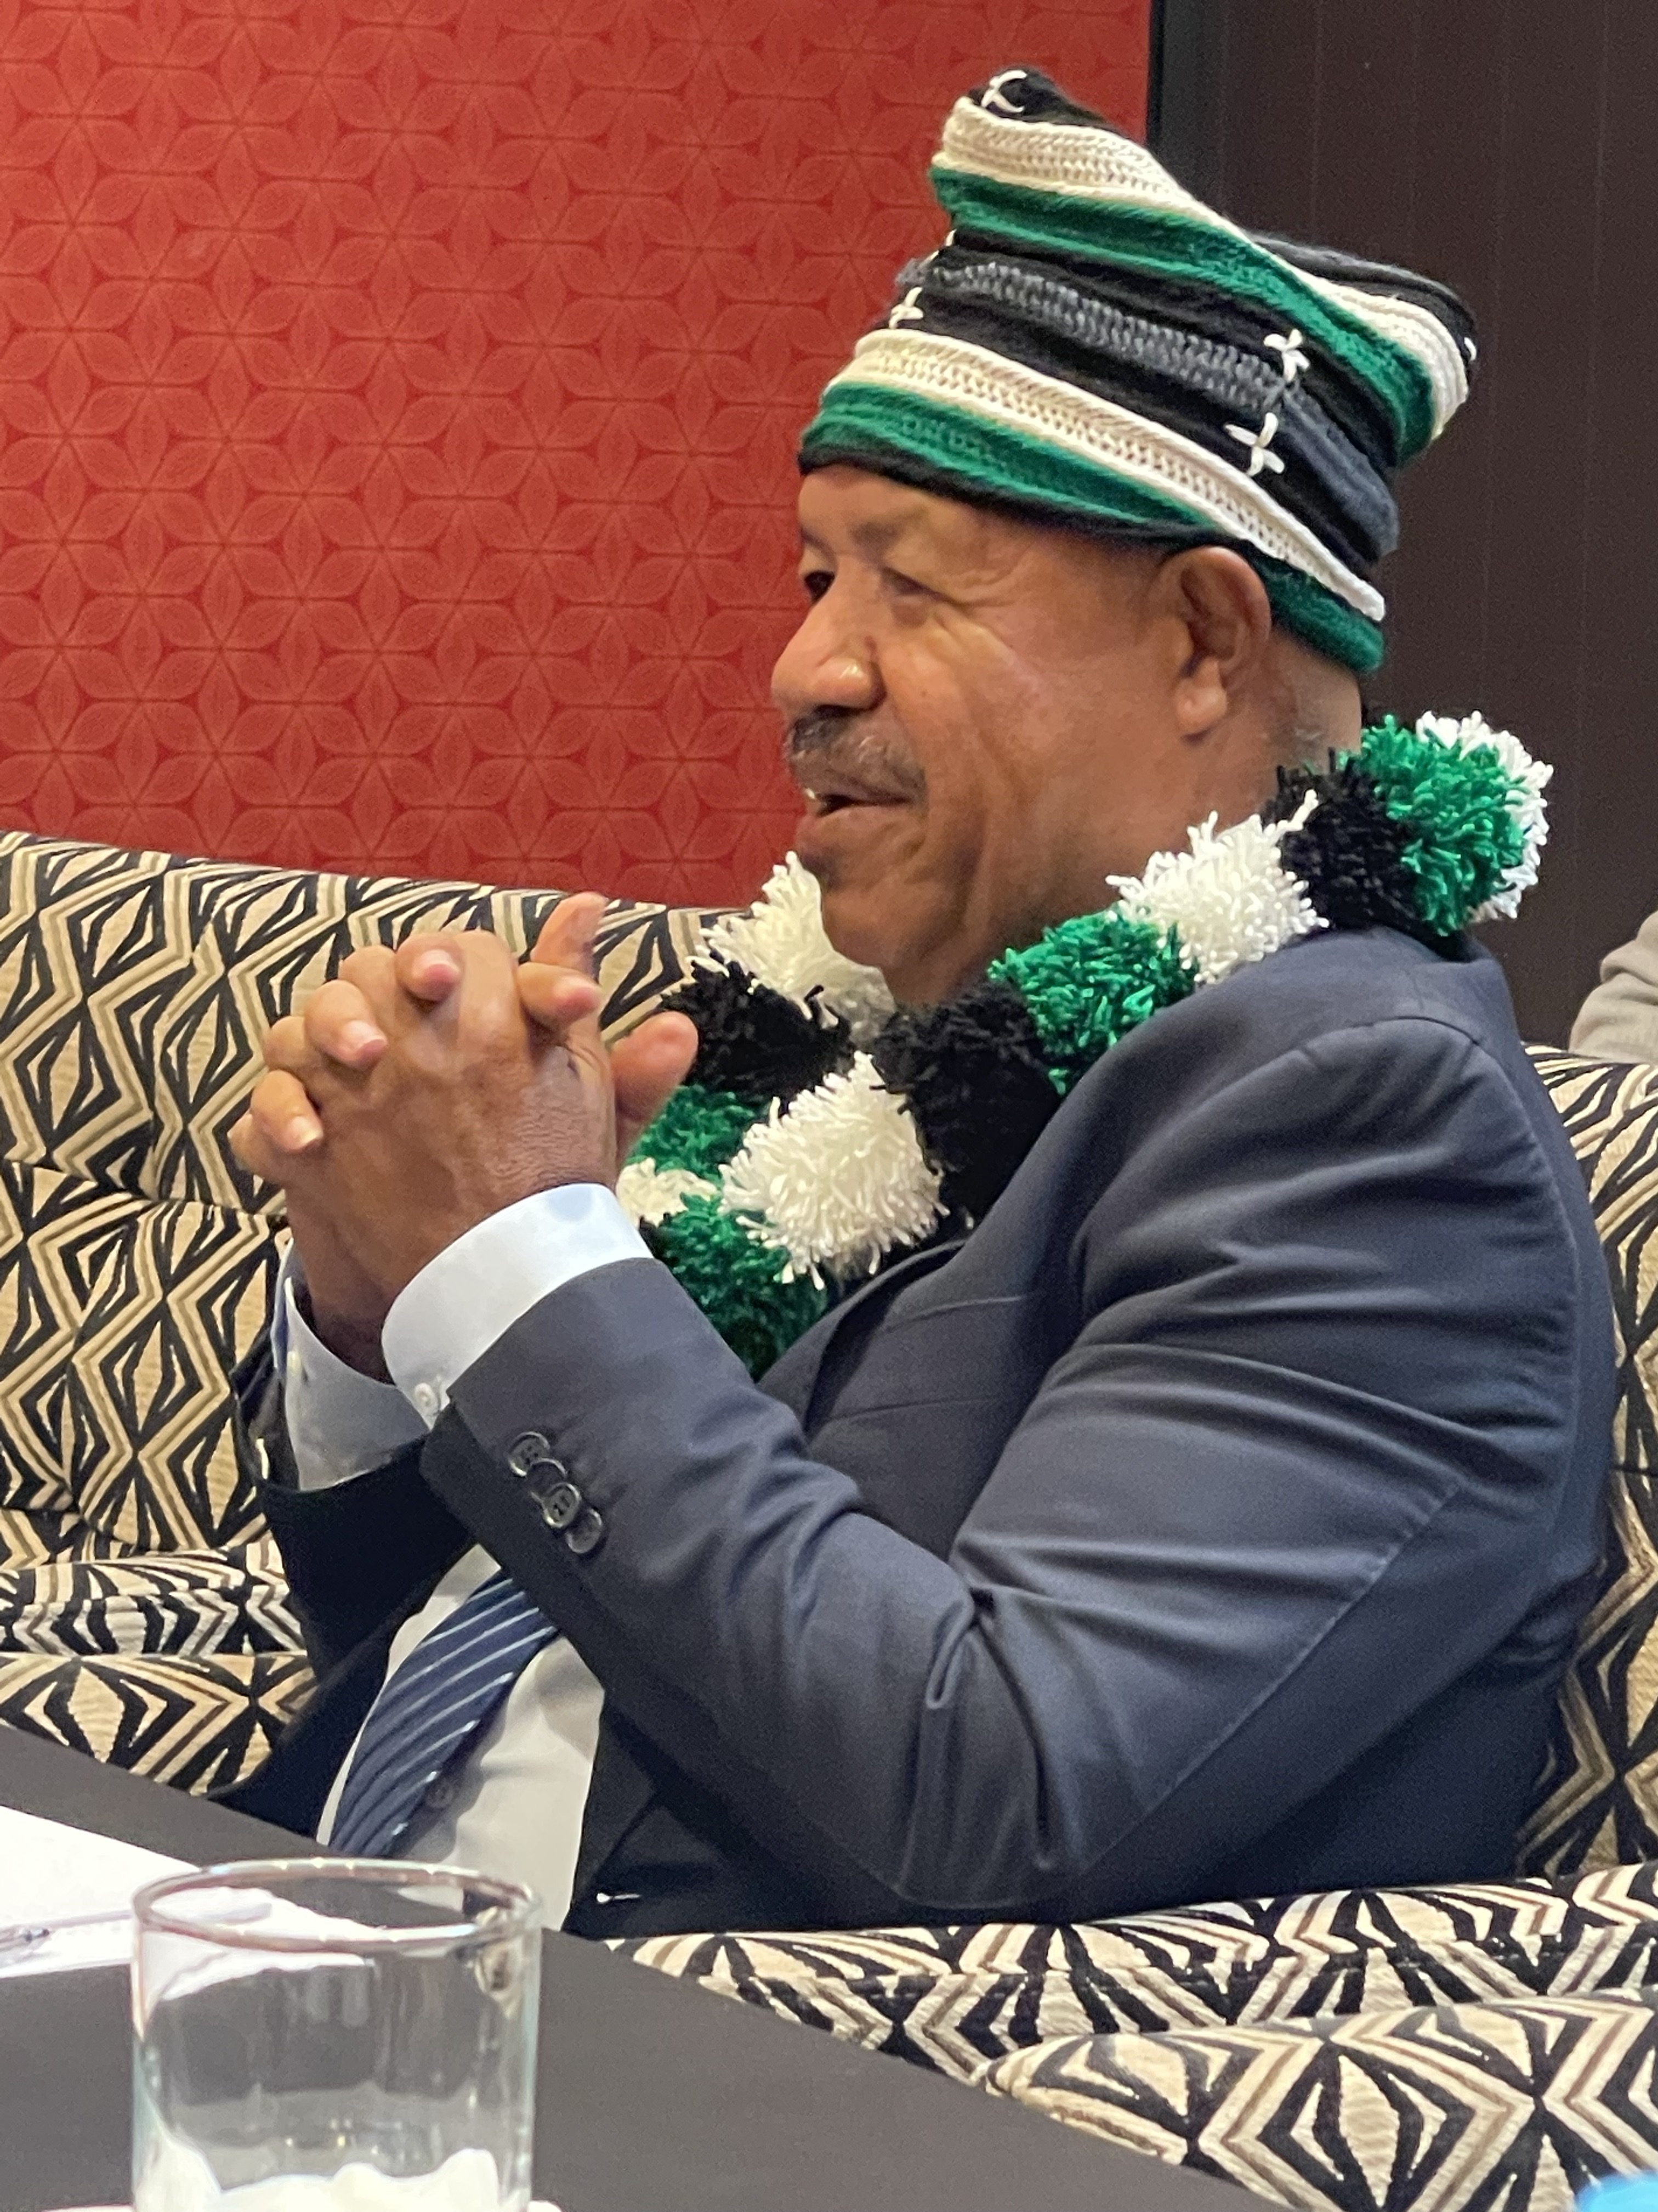
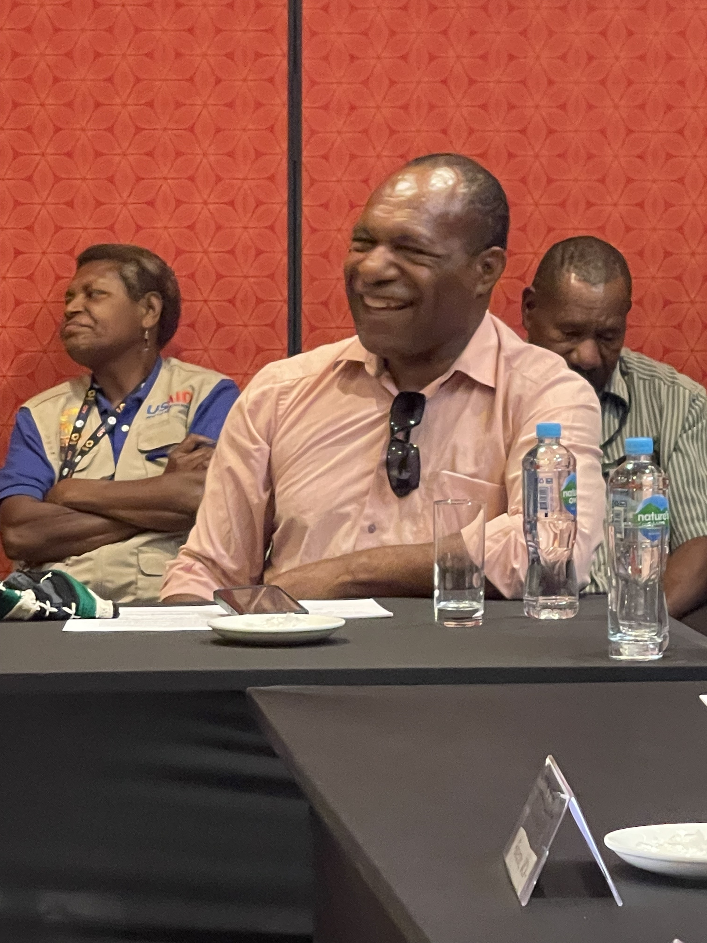
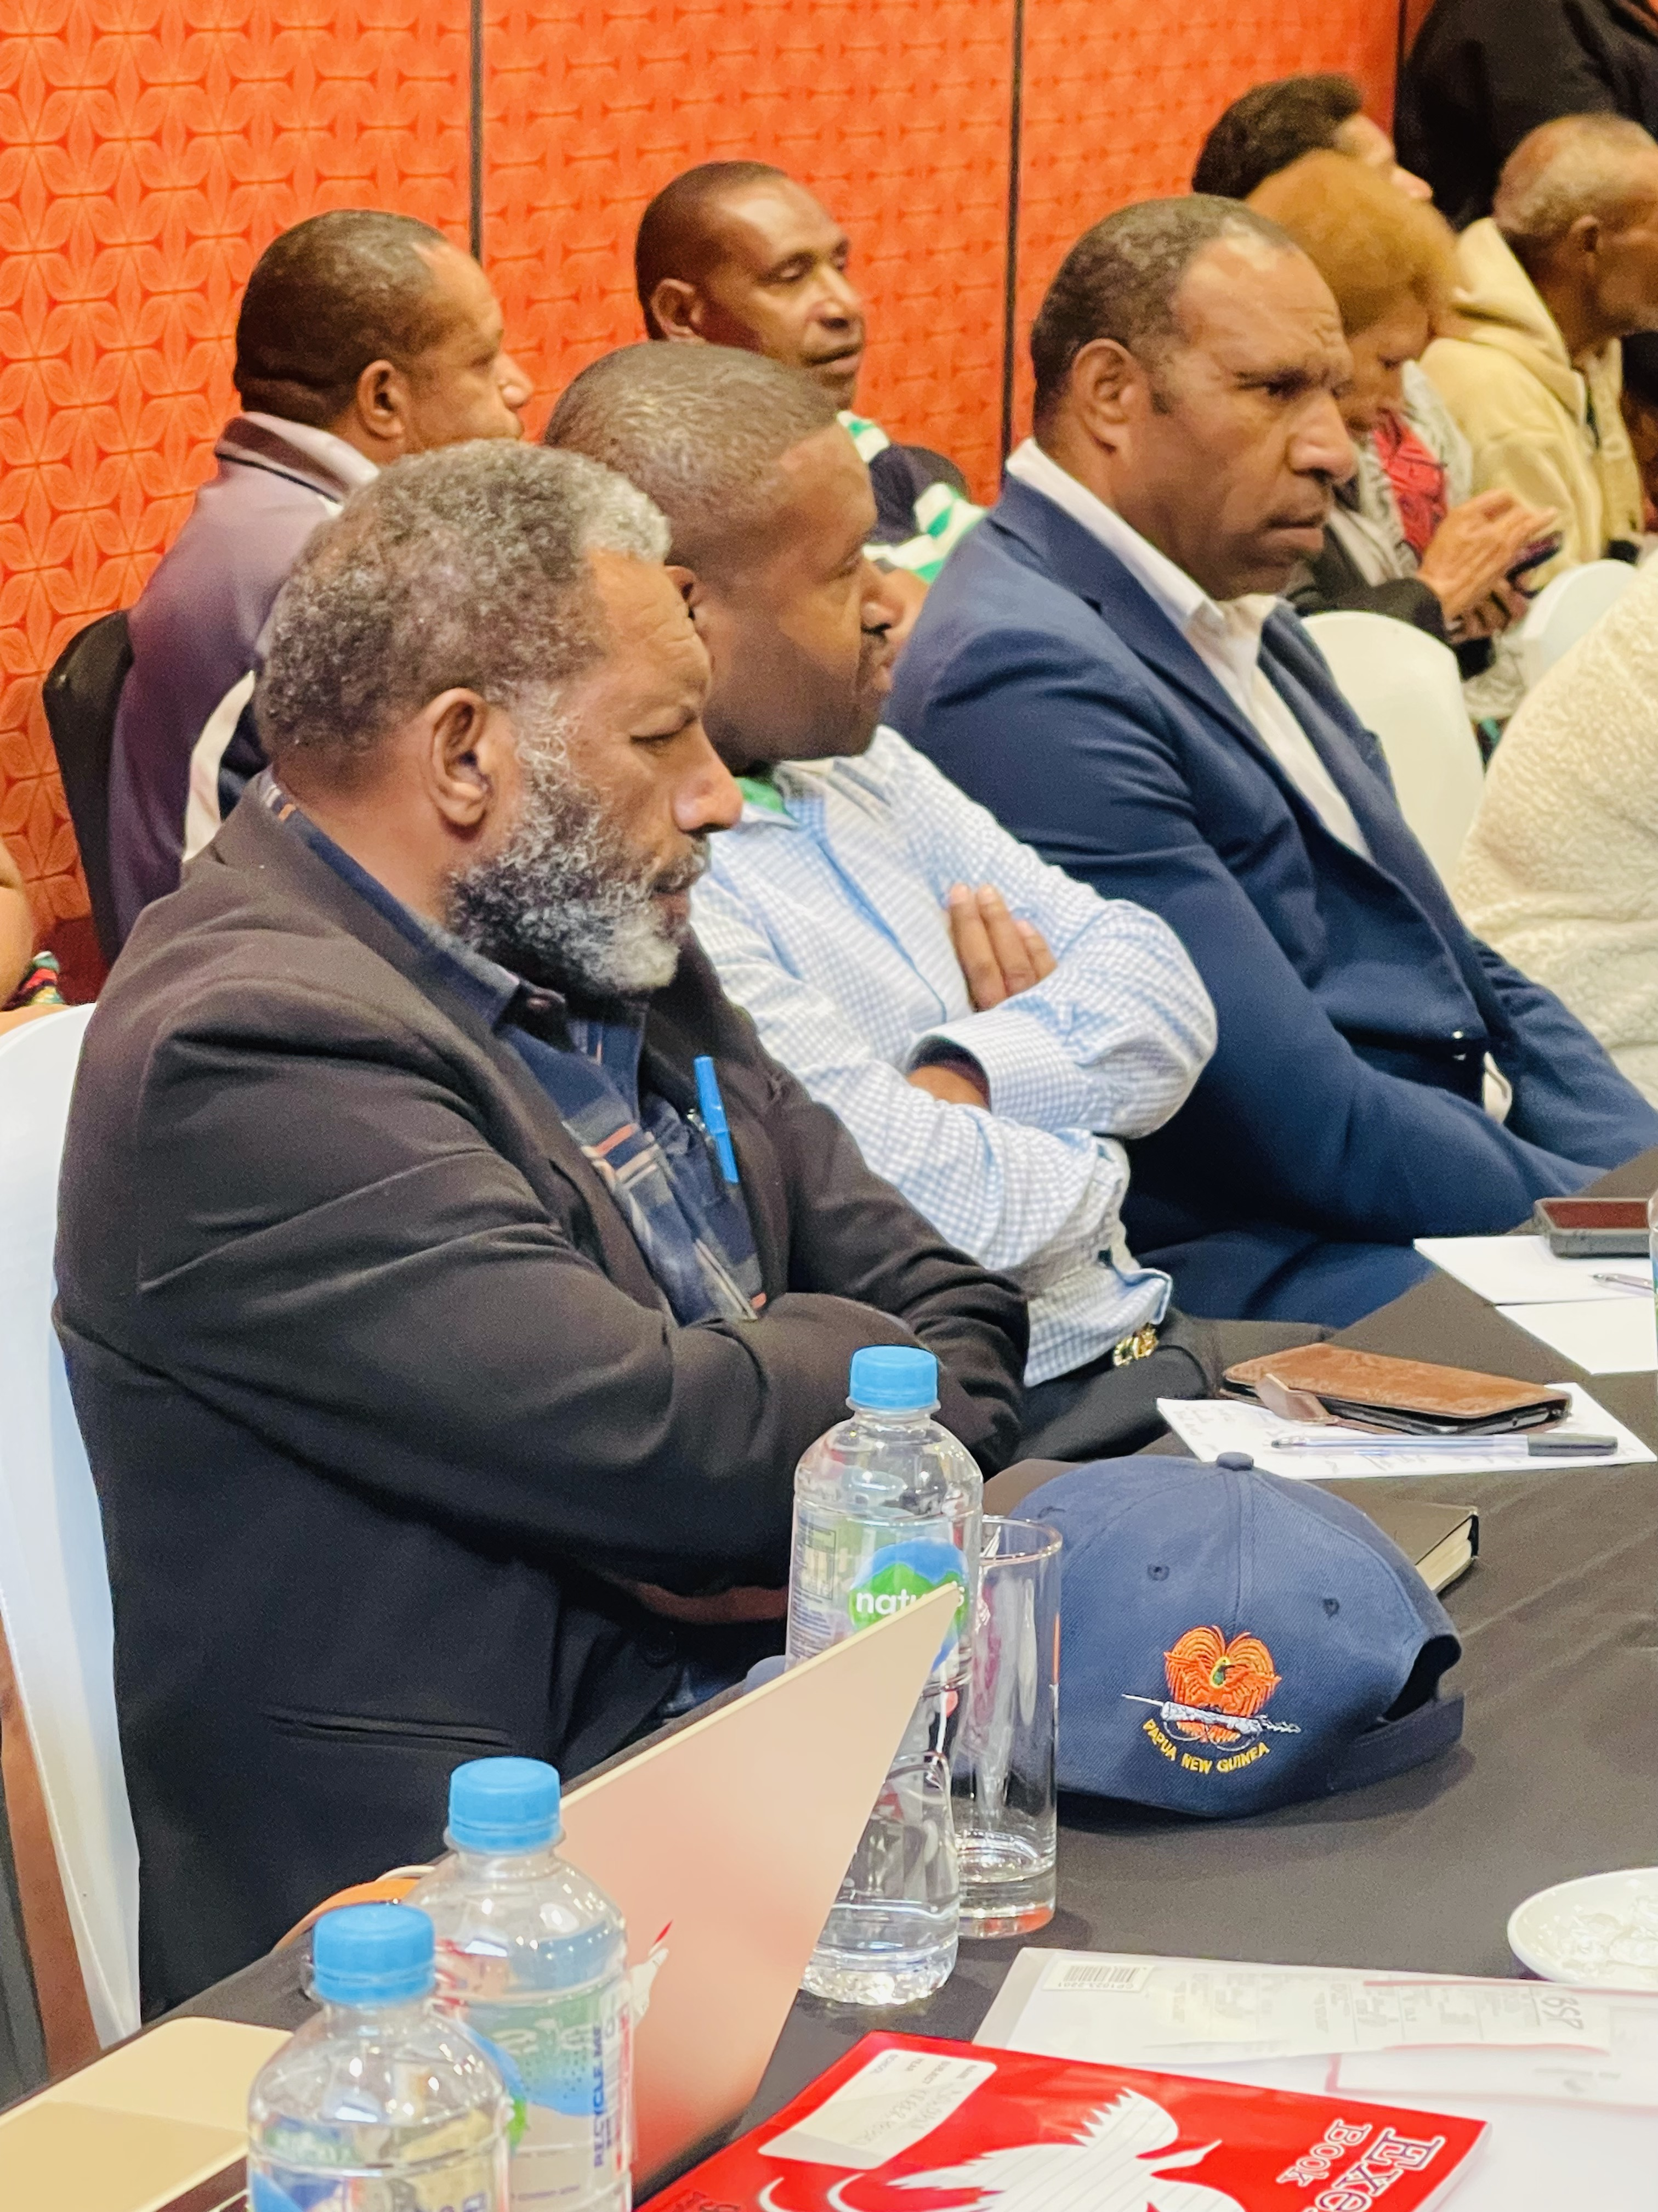

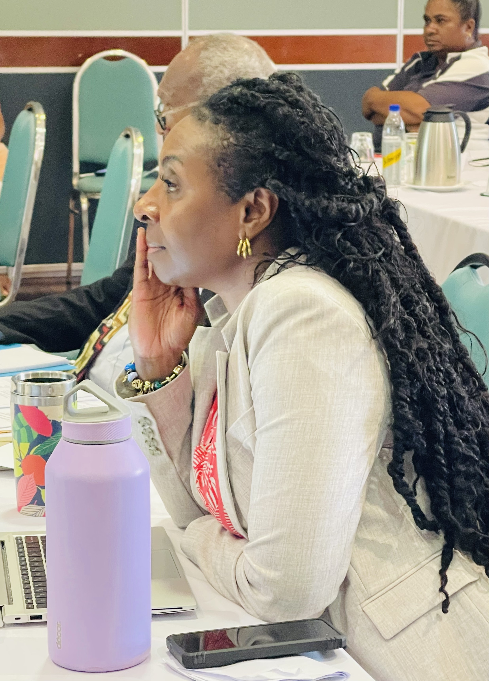
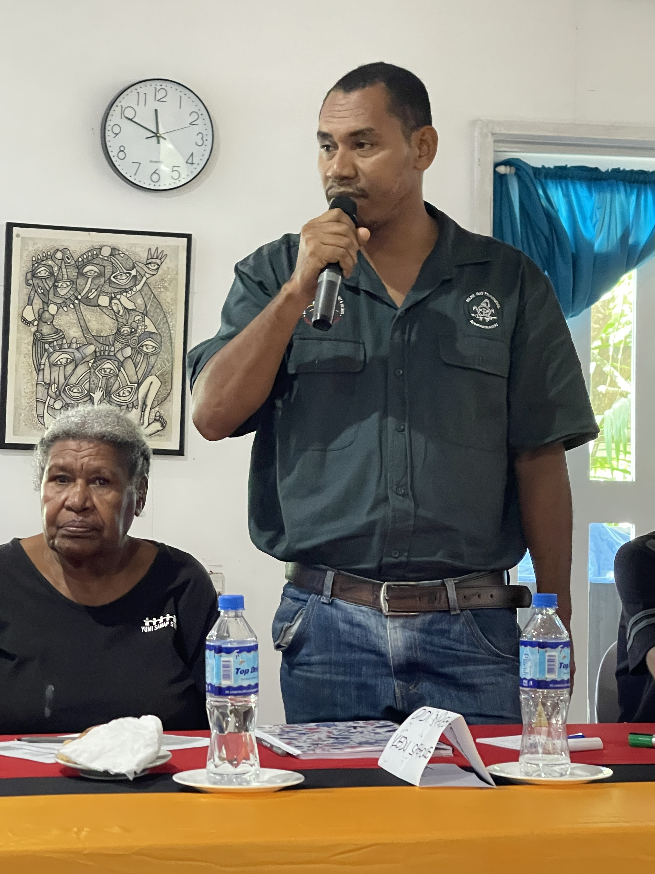
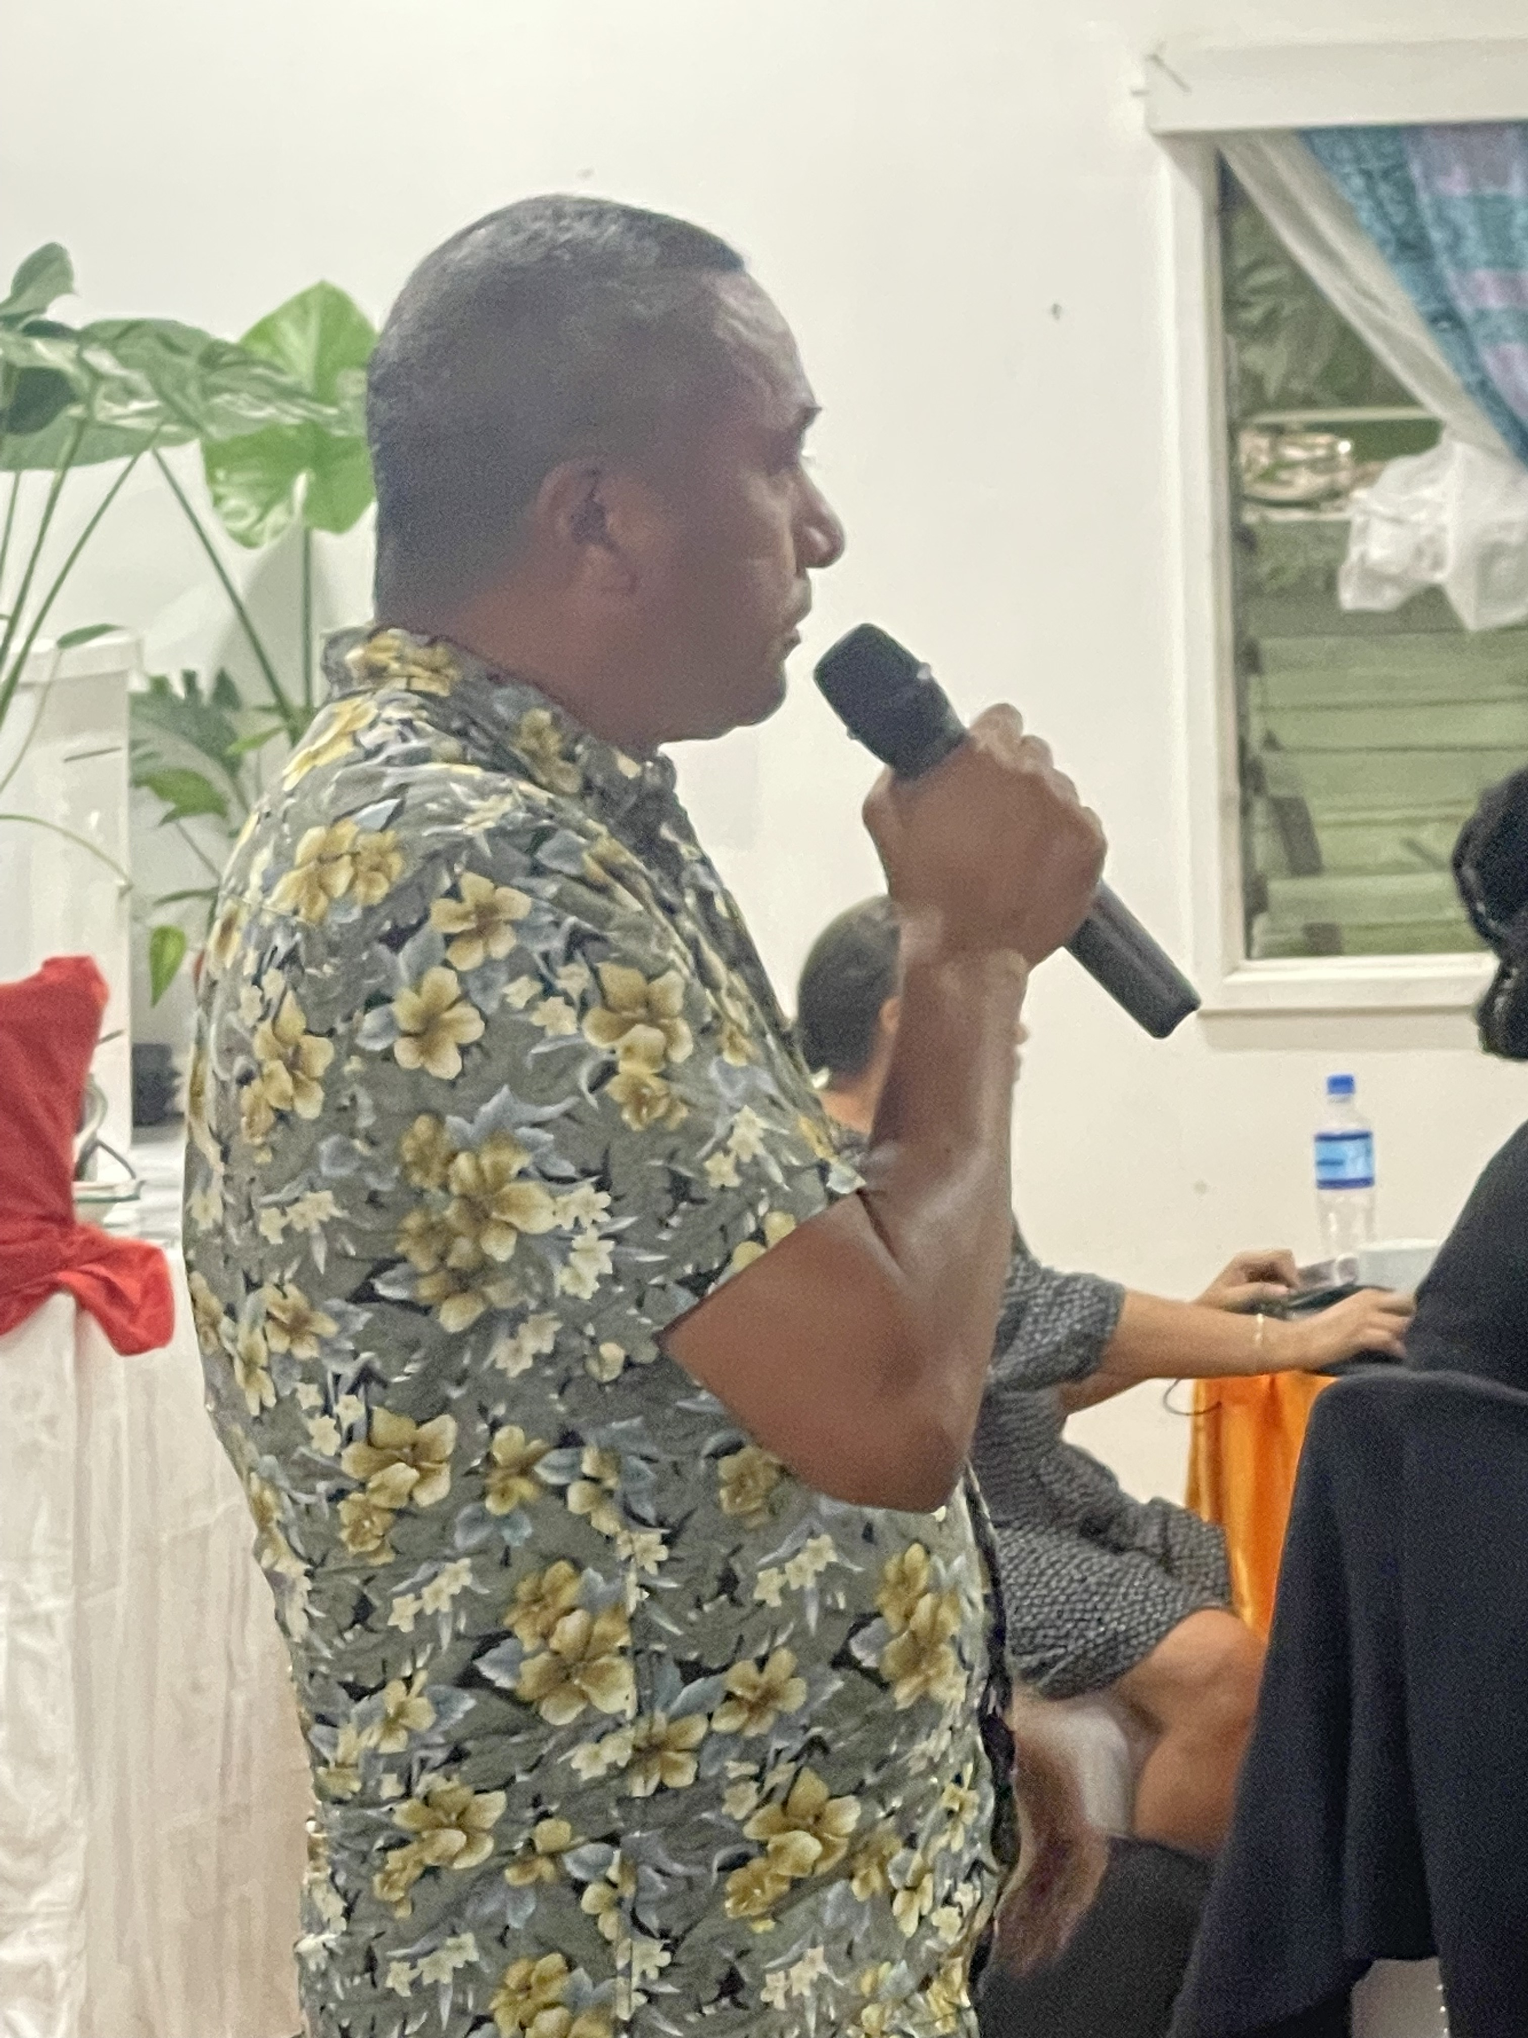
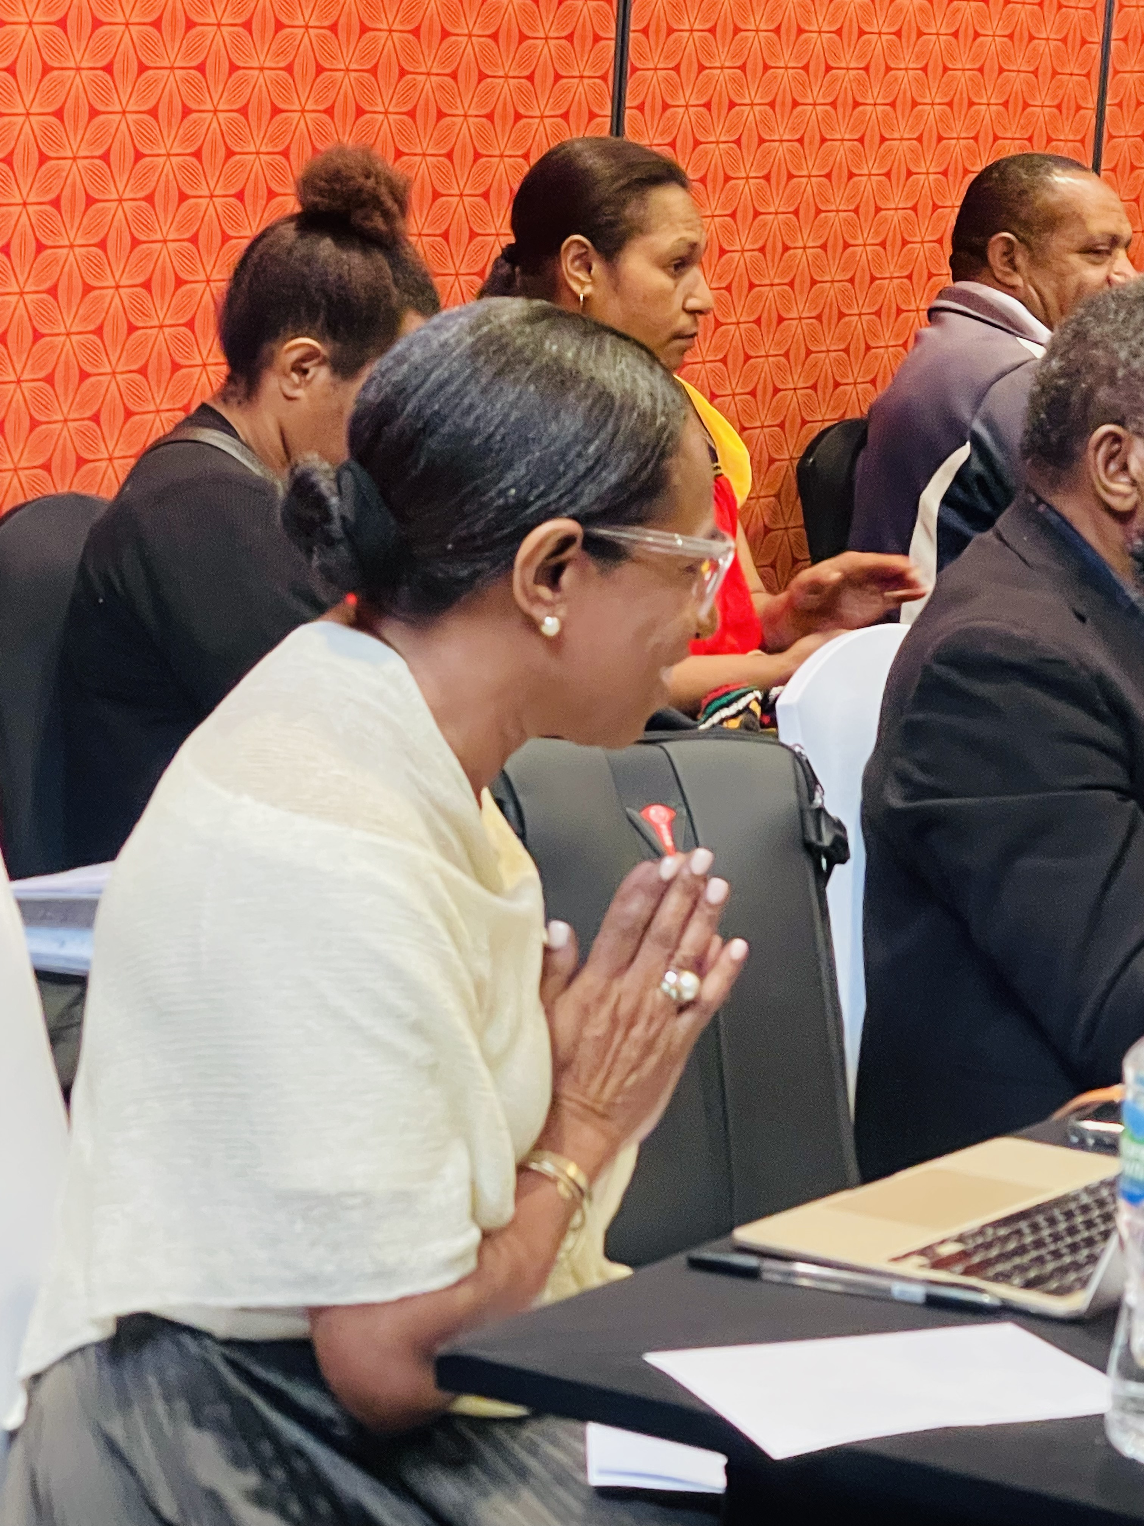
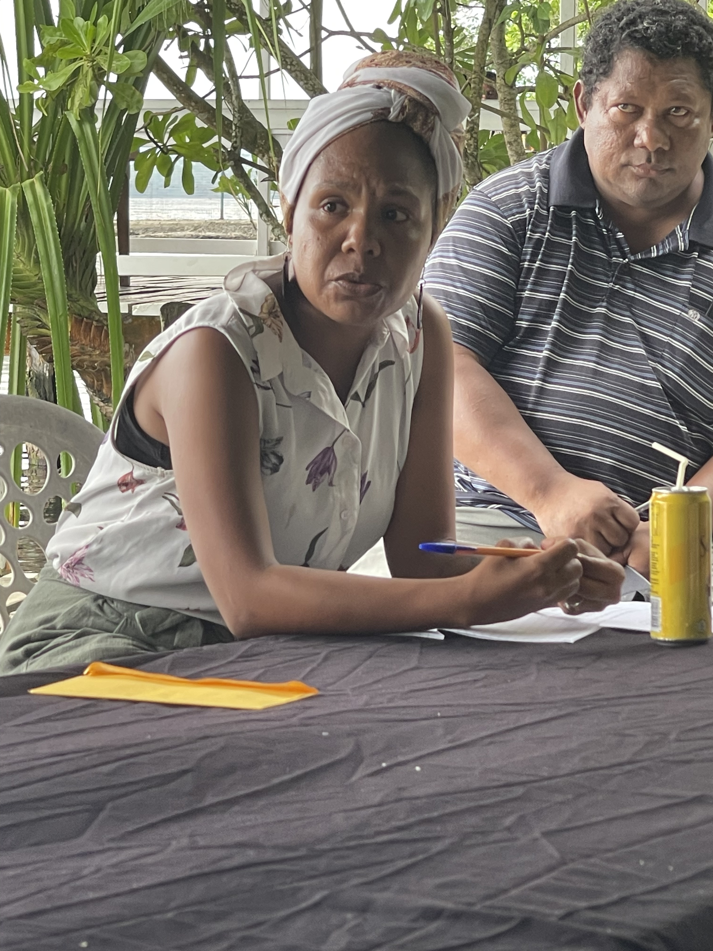
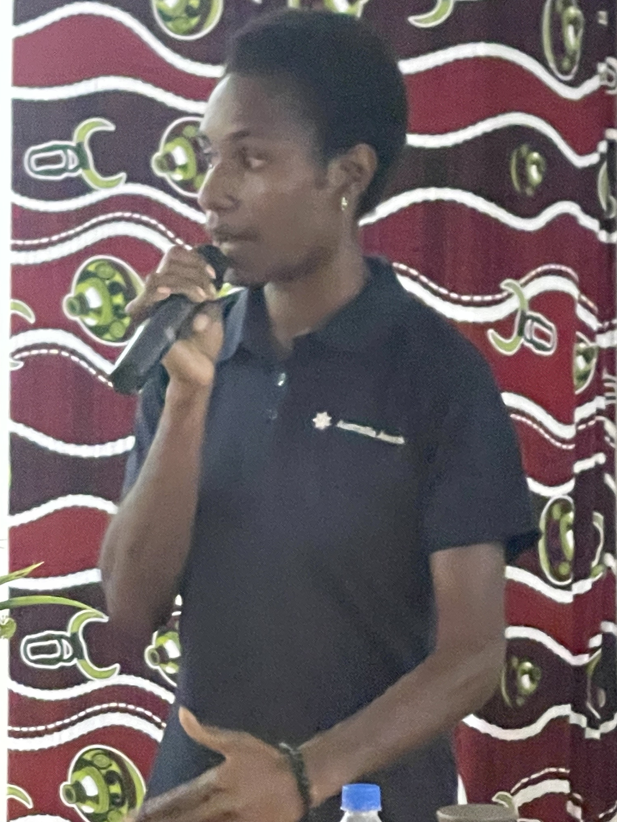
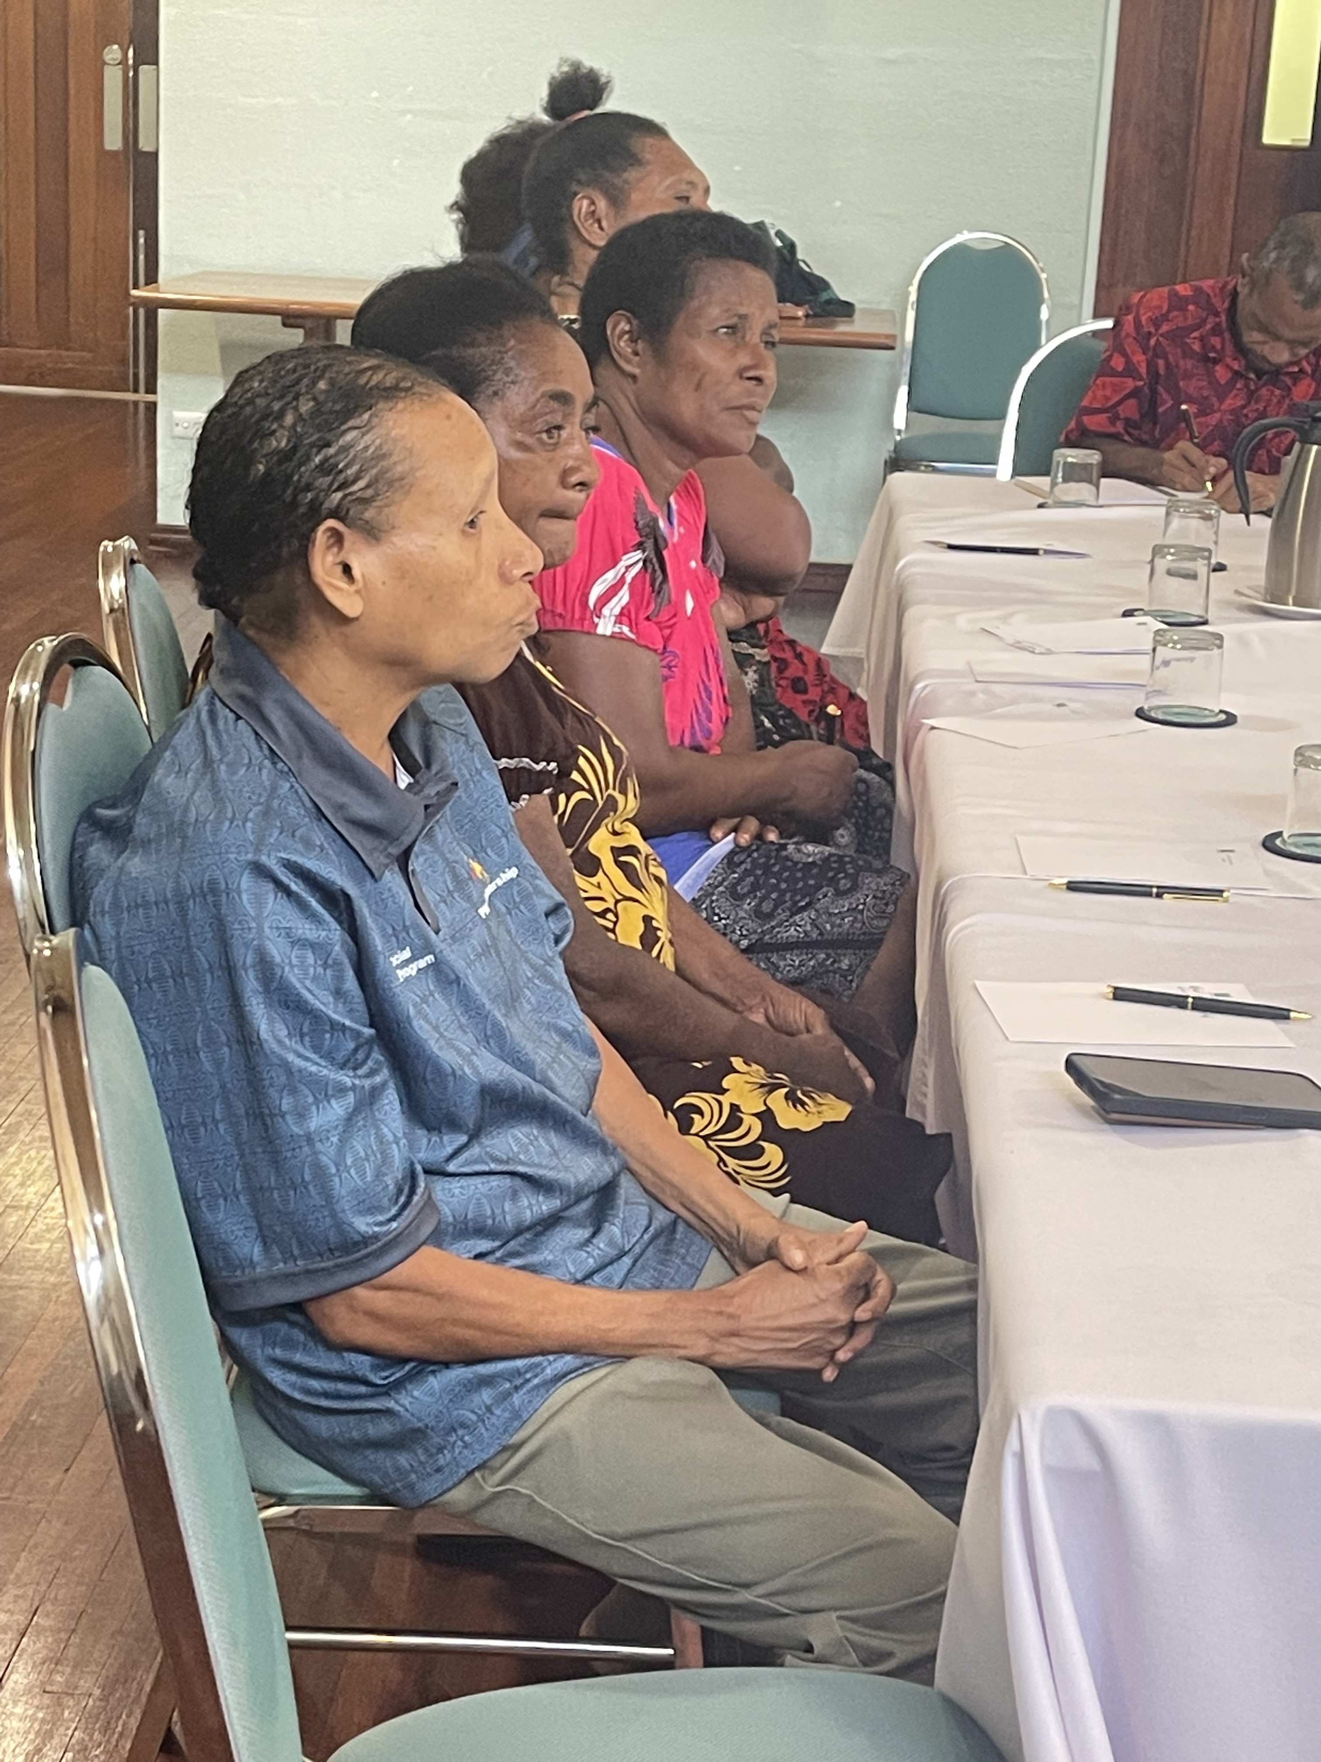
`
At the sub-national level participants shared their views on the major challenges.
Deeply ingrained cultural beliefs and practices such as bride price, traditional village court compensation systems and gender role expectations.
Inadequate resources and funding including actual budget funding, trained human resources and logistical support like office equipment and supplies, and sufficient means of transportation.
Weak law enforcement and judicial systems including biased policing, along with an inefficient and underfunded judiciary, make it difficult to hold perpetrators accountable and provide protection and justice for survivors.
Unavailable and inaccurate data and low capacity makes it nearly impossible to identify trends, measure progress, and inform policy decisions.
Training, and Monitoring and Evaluation for law enforcement officers, courts, village magistrates, healthcare providers, teachers and community leaders to ensure they are equipped to handle GBV cases sensitively, confidentially and effectively.
Political Will at all levels of government is lacking. Evidence points particularly a lack of engagement at the Provincial Government level but also at the most senior levels in police and judiciary system.

Slide 17
 | GBV Rate 2016 | Strategy | PEC √ | Focal Point | Funded | FSVU | GBVAC | Meet? | Village Courts | FSC | Safe House
ARoB | 52% | Yes | Yes | Yes | K487,000 | 3 | yes | Yes | 506 | 3 | 8
Central | 57% | Yes | No | No | No | 2 | No | No | 469 | 0 | 2
Chimbu | 48% | Yes | No | Yes | No | 2 | Yes | Yes | 742 | 2 | 0
EHP | 67% | Yes | No | Yes | K100,000 | 3 | Yes | Yes | 749 | 1 | 6
ENB | 61% | Yes | Yes | Yes | K60,000 | 2 | Yes | Yes | 294 | 2 | 1
ESP | 42% | Yes | Yes | Yes | K500,000 | 3 | Yes | Yes | 742 | 2 | 0
Enga | 61% | Yes | Yes | Yes | K70,000 | 3 | Yes | Yes | 154 | 1 | 0
Gulf | 46% | Yes | Yes | Yes | K500,000 | 1 | Yes | Yes | 357 | 0 | 3
Hela | 70% | Yes | No | Yes | No | 1 | Yes | Yes | 301 | 16 | 1
Jiwaka | 50% | Yes | No | Yes | K500,000 | 3 | Yes | Yes | 315 | 1 | 3
Madang | 49% | Yes | No | Yes | No | 2 | No | Yes | 623 | 1 | 1
Manus | 66% | WIP | No | Yes | No | 1 | No | No | 329 | 0 | 0
Milne Bay | 64% | Yes | Yes | Yes | K75,0000 | 1 | Yes | Yes | 546 | 1 | 1
Morobe | 59% | WIP | No | Yes | K3,000,000 | 18 | Yes | Yes | 609 | 1 | 4
NIP | 63% | Yes | No | Yes | No | 0 | Yes | Yes | 280 | 0 | 0
NCD | 63% | Yes | Yes | Yes | K2,000,000 | 8 | Yes | No | 189 | 1 | 7
Oro | 45% | Yes | No | Yes | K2,000,000 | 1 | Yes | Yes | 301 | 0 | 1
SHP | 49% | Yes | Yes | Yes | No | 7 | Yes | Yes | 111 | 7 | 5
Western | 49% | Yes | No | No | Yes | 2 | Yes | No | 294 | 1 | 0
WNB | 59% | Yes | Yes | Yes | K30,000 | 1 | Yes | Yes | 308 | 1 | 3
WHP | 53% | Yes | No | Yes | No | 2 | No | No | 497 | 5 | 7
WSP | 50% | Yes | No | Yes | K10,000 | 1 | Yes | Yes | 322 | 1 | 1
Notes:
20 provinces have GBV strategies
20 provinces have GBV focal points
A total of K8,845,000.00 per annum is allocated to GBV by all provinces.
12 provinces include GBV in their budgets.
There are 18 existing GBVAC, 16 of which held a GBVAC meeting in the last year.

Slide 18
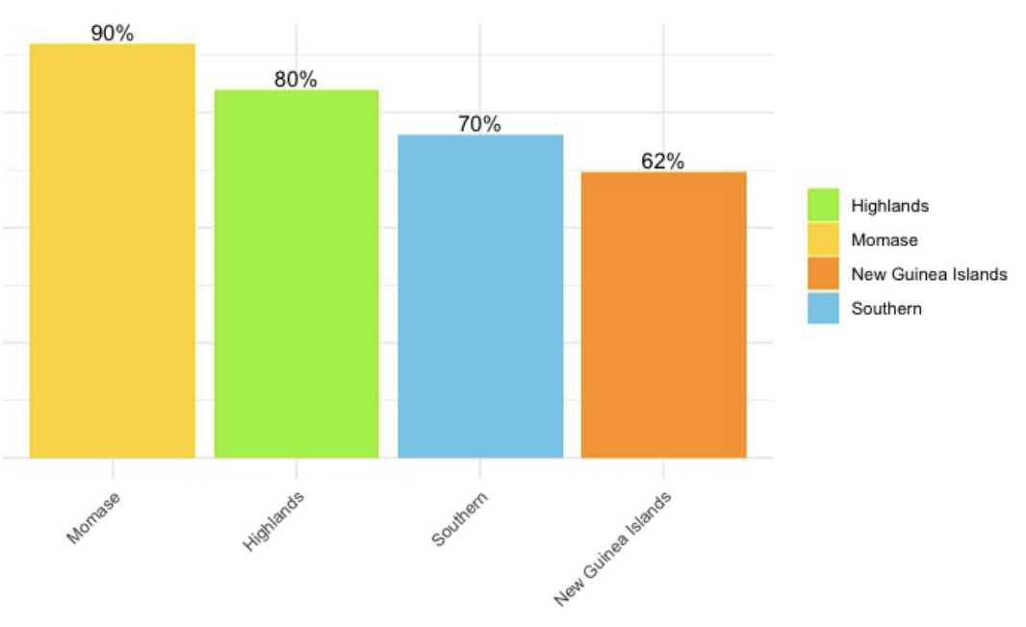
Momase has the worst rates of violence where 90% of women say they have survived GBV, followed by the Highlands (80%), Southern (70%) and the NGIs (62%).

Slide 19
Gender-based Violence costs Papua New Guinea a lot.
An estimated annual national loss of 18 million days work lost to violence-related disruptions.
For an estimated annual national productivity loss of 118.6 billion K
And this does not include the cost of police, justice, health care, resultant trauma-affected behaviour, and loss of life and dreams.

Slide 20
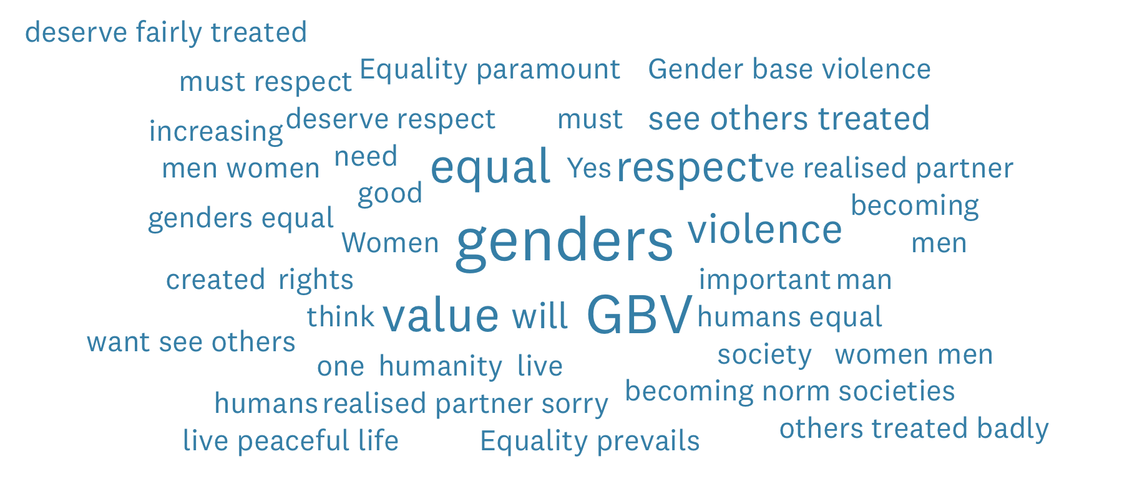
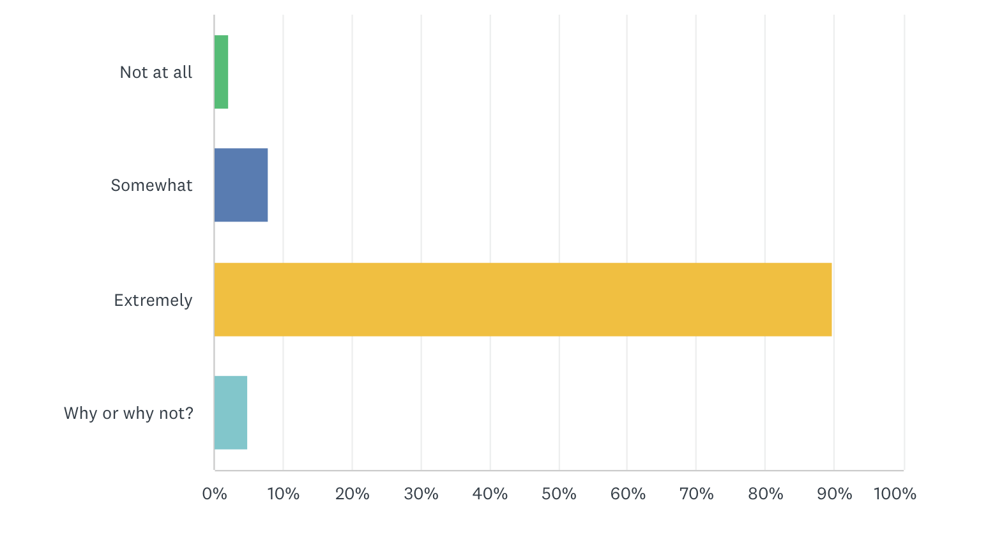
At the same time, 90% of women and 86% of men believe ending gender-based violence is extremely important to PNG.

Slide 21
And the Government is responding the demands of the people.
The establishment of the Coalition of Parliamentarians to end GBV, the Special Parliamentary Committee on GBV and the Permanent Parliamentary Committee on GEWE.
Two Parliamentary Inquiries on GBV and three national summits on GBV and GEWE with the PM attending 2 of them.
The appointment of a woman Speaker in Parliament.
The National GBV Secretariat has been established and funded.
The NGBVS now has a grants program in place (K4.7 million given from 2022-2024 to CSOs) and K427,250 from 2023 to 2024 to provincial governments.

Slide 22
And at the provincial level action has happened.
20 new provincial strategies, budgets and activities.
12 of the strategies are funded.
20 Provinces with GBV focal points.
5 fully established GBV secretariates.
FSVUs and FSCs across the country.

Slide 23
Critical laws are being amended and strategies developed
The Family Protection Act (2022).
The amendment of the ILO Convention on Violence and Harassment led by the Trade Union Congress (2020).
The launch of the SARV National Action Plan (2018).
The review of the National GBV Strategy.

Slide 24
And CSOs and and frontline workers have stepped up to the plate. A few examples…
A national network of more than 600 human rights defenders and private sector action like the Bel Isi coalition and the Men of Honour program.
Outstanding youth focused prevention programs like Equal Playing Field, Active City, Sanap Wantaim and the Voice for Change.
More readily available GBV data and information, and a wealth of new research.

Slide 25
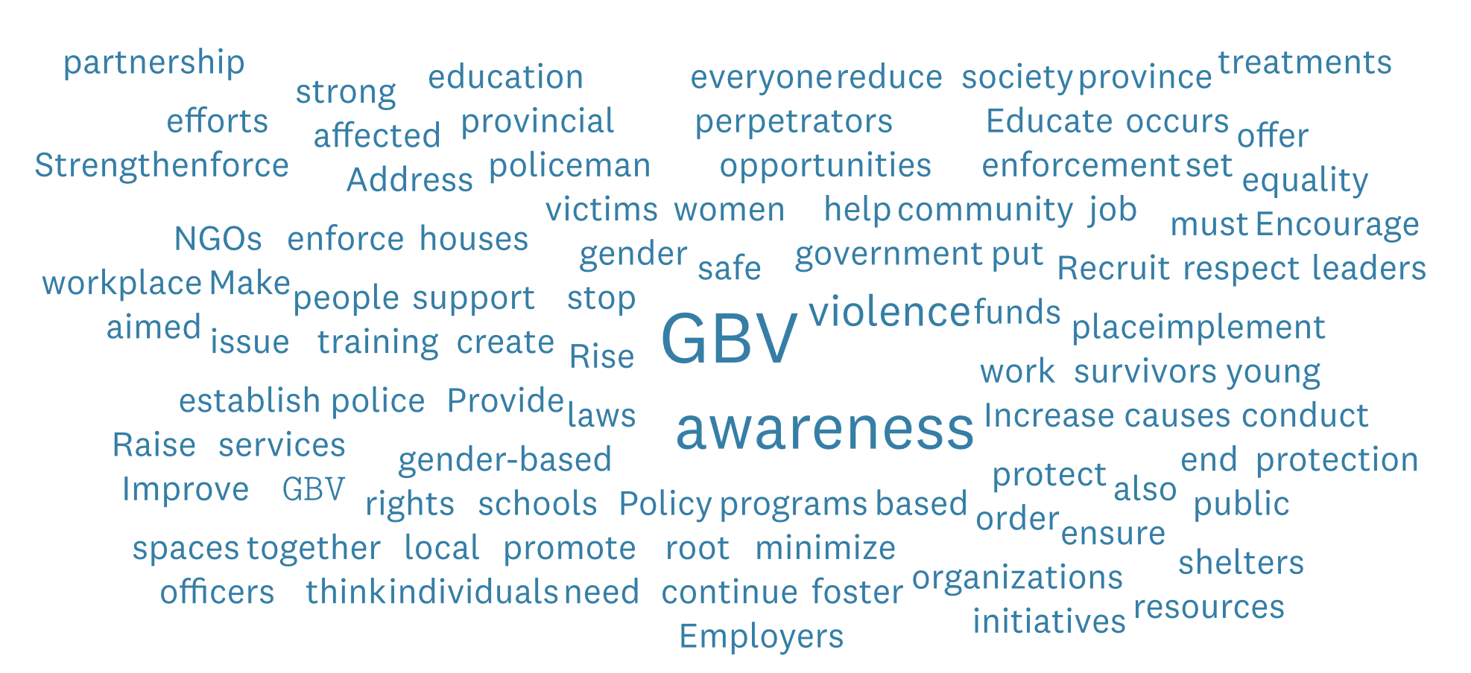
What more do we need?
Better services, skilled duty-bearers and more awareness about gender-based violence, its impact and how to better address relationship problems.

Slide 26
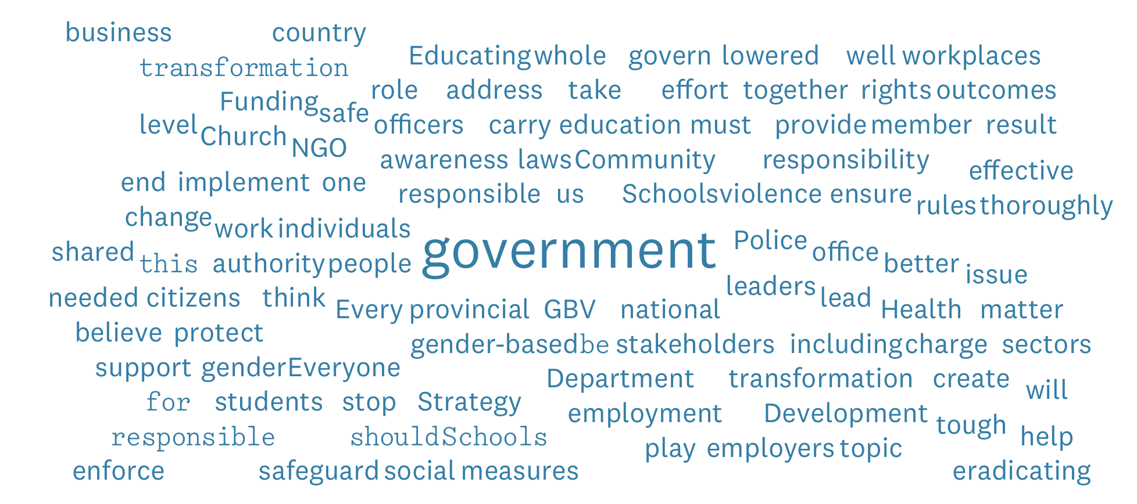
Who is responsible to drive the change?
Everybody is responsible, but most particularly the national and provincial governments.

Slide 27
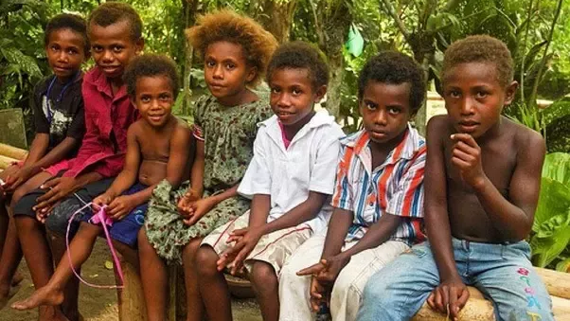
Thank You

